Slide 1
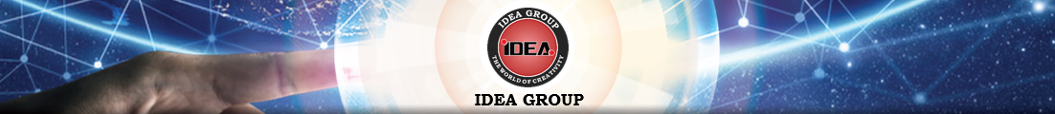



COMPANY PROFILE
Innovation for the better life
TẬP ĐOÀN CÔNG NGHỆ IDEA
IDEA TECHNOLOGY CORPORATION JOINT STOCK COMPANY
Japan Technology – Made by IDEA
Machine Design – Automated Machines
Robot System – AGV - IoT
UNITY – CREATIVITY – DEVELOPMENT
(+84) 28 73 013 779
info@ideagroupvn.com
www.ideagroupvn.com

Slide 2

Table of contents
Overview of IDEA Group
History of development
Vision - Mission - Organizational chart
Branch offices
Markets and yearly revenue
Products and services
7. Cultural activities
8. Senior leaders’ visits
9. Typical achievements

Slide 3
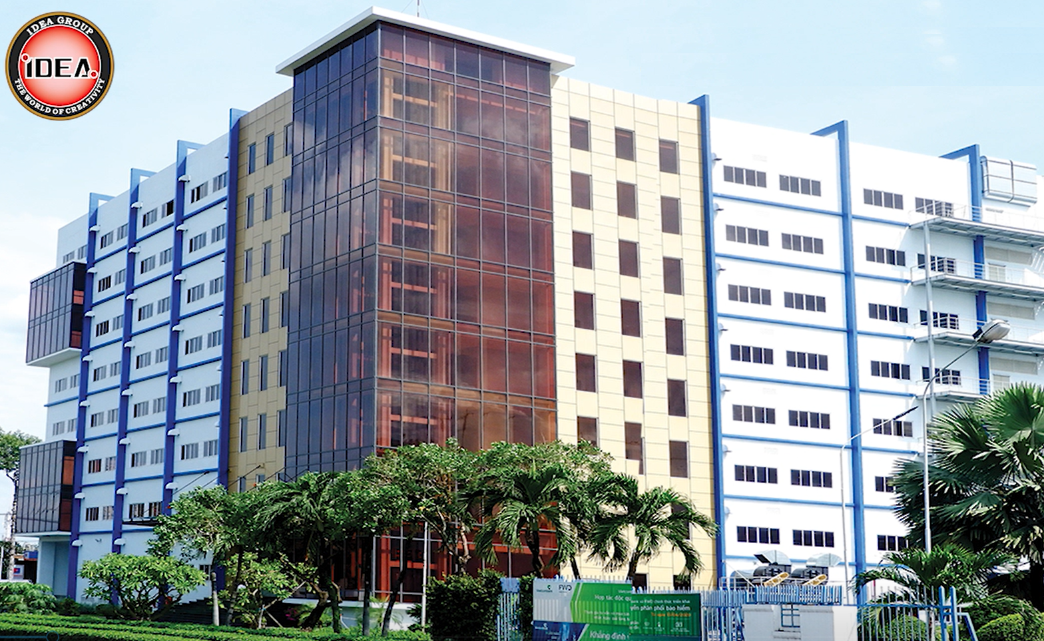
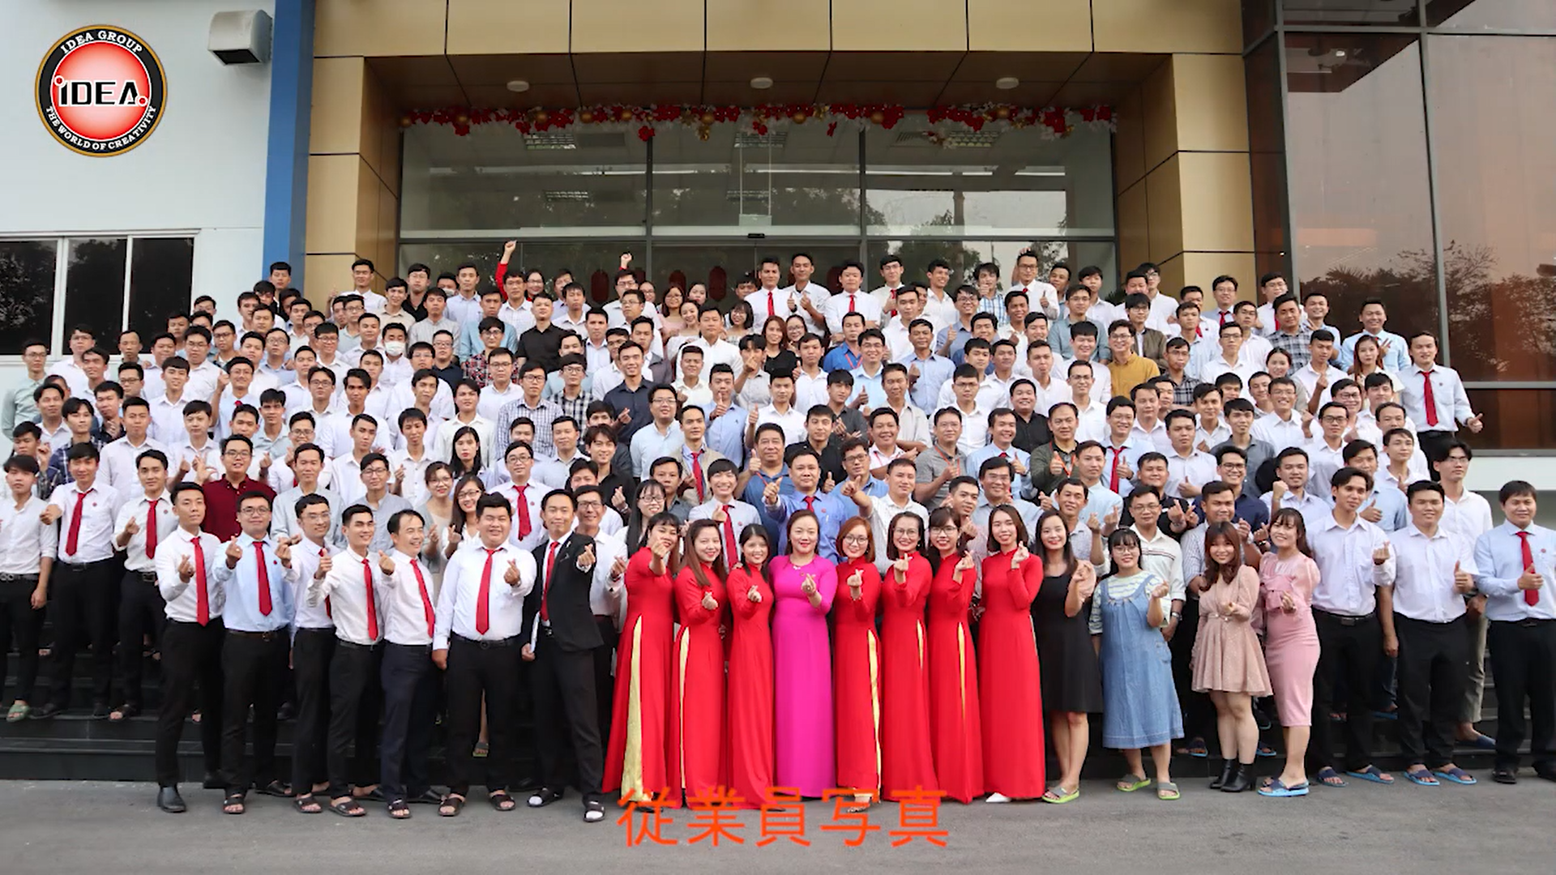
1. OVERVIEW OF IDEA GROUP
Company Name
Foundation
Charter capital
General director
Business
: IDEA TECHNOLOGY CORPORATION JSC
: 04/05/2010
: 35,000,000,000 VNĐ
: Mr. Do Hoang Trung
: Parent company (IDEA), including 4 divisions,
2 subsidiaries and 2 joint ventures
Design, mechanical processing, automated
machine manufacturing
: 250
: (+84) 28 73 013 779
: info@ideagroupvn.com
: https://www.ideagroupvn.com
: https://www.facebook.com/ideagroupvn/
: https://www.youtube.com/@ideagroupmarket
Number of staff
Tel
E-mail
Website
Facebook
Youtube
IDEA GROUP’ S FEATURES
1. Our partners and clients are mostly Japanese corporations and companies (more than 200 companies).
2. The design staff is large, the scale is among the top companies in Vietnam (more than 150 people).
3. We are capable of developing robots, AGVs and automated machines in the manufacturing industry.
4. We can meet Japanese and American JIS design standards.
5. We can design from ideas, process, manufacture and assemble completely by companies in the group.

Slide 4
2. HISTORY OF DEVELOPMENT
Date | Event
01-2003 | The founder of IDEA Group returned from Japan
01-2006 | Established and magaged Japanese company in Vietnam
05-2010 | Foundation IDEA Technology Joint Stock Company
05-2015 | Contritubed capital to processing factory VIJA
12-2013 | Established technology and trading company ITTC
07-2015 | Established automation and machine manufacturing company ITDC
01-2016 | Established design and machine manufacturing company ITSC in Danang
01-2017 | Established precision mechanical processing, jig manufacturing company ITMC
10-2018 | Established high-tech research and development company ITHC
05-2020 | Established IDEA Holdings, formerly known as IDEA Technology JSC, becoming the parent company of IDEA Group, called IDEA for short
01-2021 | Relocated 4 subsidiaries to Linh Trung 1 EPZ Completed the production chain from design, machining to fabrication
04-2022 | Renamed IDEA Holdings to IDEA Technology Corporation JSC, called IDEA for short

Slide 5


3. VISION – MISSION – CORE VALUES OF IDEA GROUP
1. Vision
IDEA Group aims to become the leading Technology - Technical Service Corporation in Vietnam.
2. Mission
Contribute to the development of the industry
Elevate the value of Vietnamese enterprises
3. Core values
Compliance – Responsibility – Courage – Speed – Gratitude
4. Business philosophy
Clients are the focus.
Employees are the mainstay.
Technology is the foundation.
UNITY – CREATIVITY – DEVELOPMENT

Slide 6
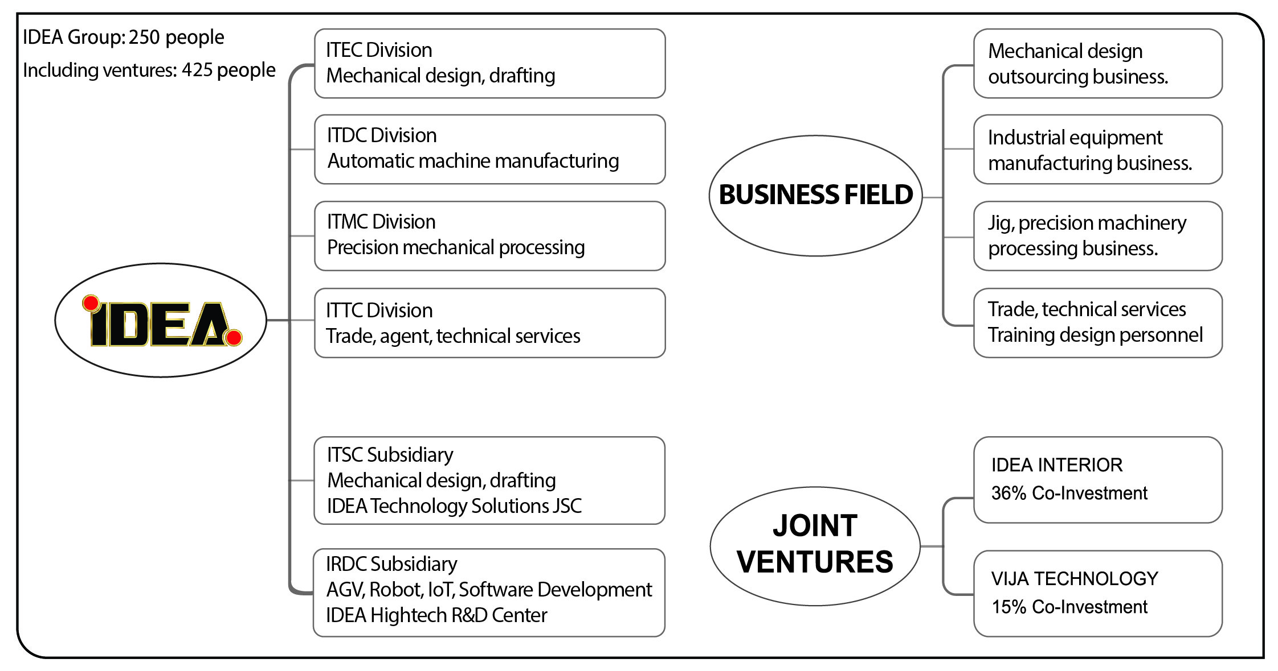
ORGANIZATIONAL CHART

Slide 7
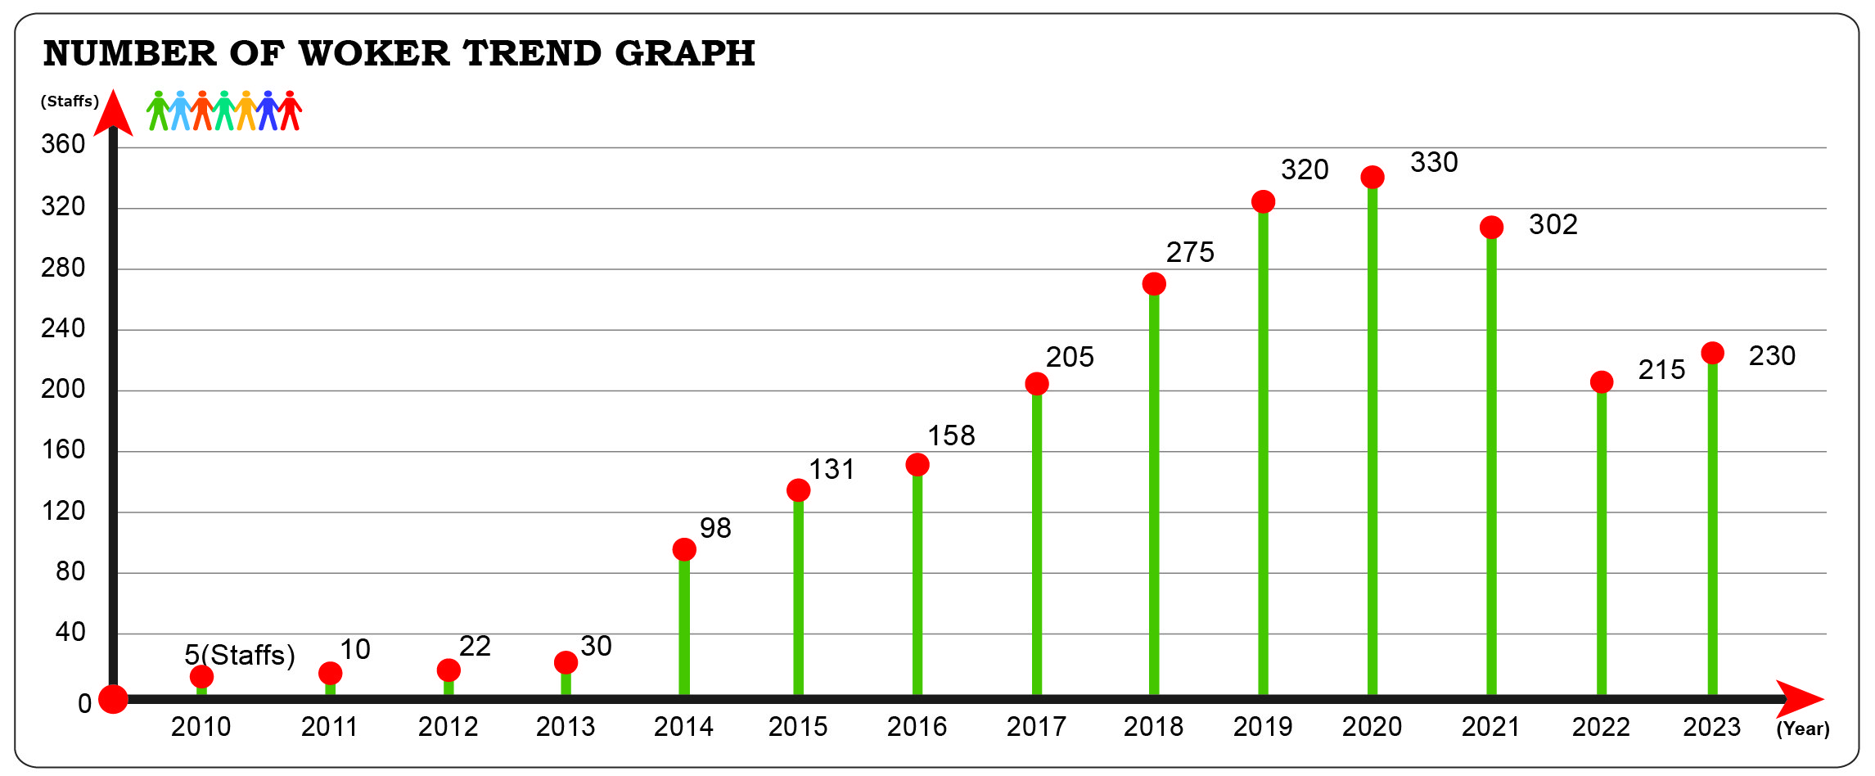
Start-up in 2010 with 5 people.
Currently, there are over 250 staffs, 70% of them graduated from Universities or Colleges, average age of 28.

Slide 8
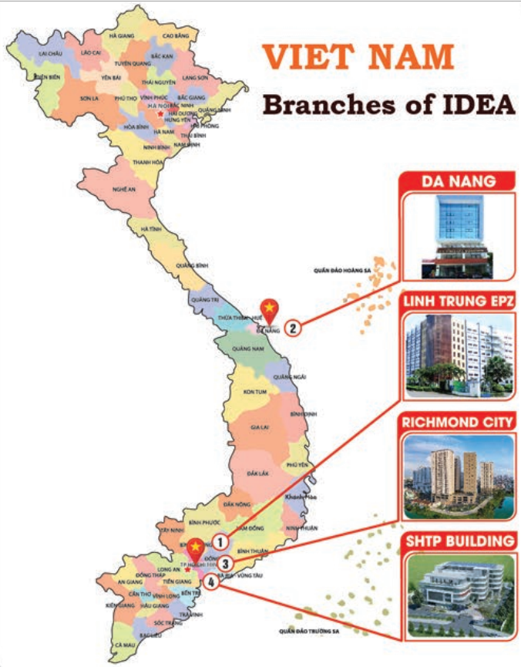
4. BRANCH OFFICES
Representative office:
8th Floor, Block Lucky Richmond City, 207C Nguyen Xi, Ward 26, Binh Thanh District, Ho Chi Minh City, Vietnam
Factory:
2nd Floor, Lot 100, Linh Trung 1 EPZ, Quarter 4, Linh Trung Ward, Thu Duc City, Ho Chi Minh City, Vietnam
Central branch:
69 Quang Trung Street, Hai Chau District, Danang City, Vietnam
R&D Center:
SAIGON HI-TECH PARK (SHTP)
Lot E2A-5, N10 Street, Long Thanh My Ward, Thu Duc City, Ho Chi Minh City, Vietnam

Slide 9
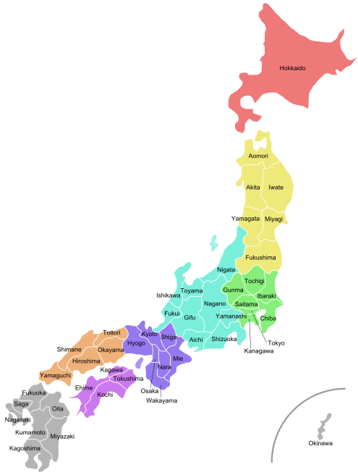
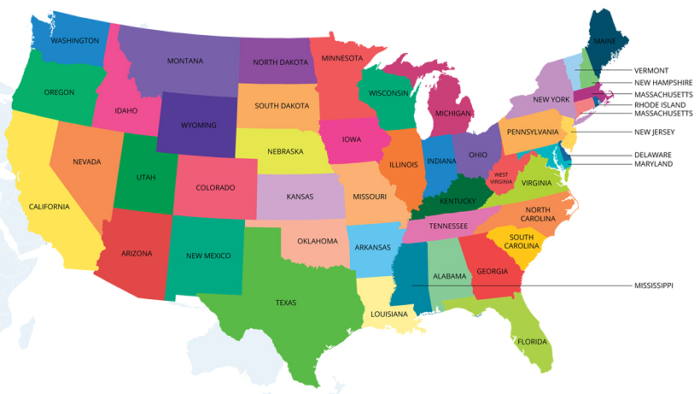
Japan Office
38-2 Shichi Jogosho No Uchinishimachi, Shimogyo-Ku, Kyoto, 600-8865 JAPAN
America Office
9999 Bellaire Blvd Ste 8B-1 Houston,
TX 77036, USA

Slide 10
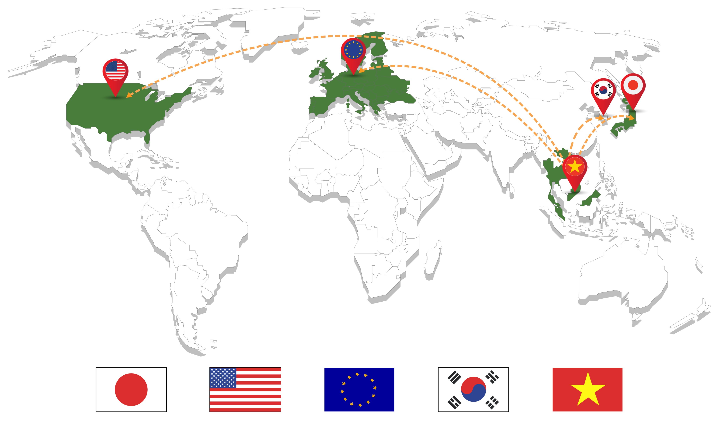
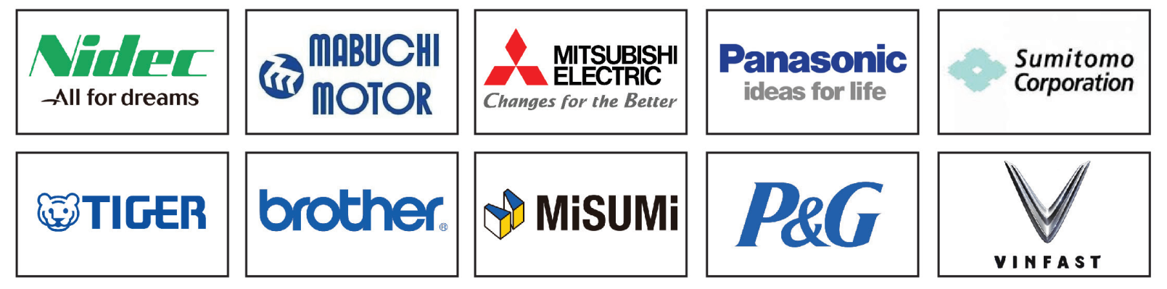
5. MARKETS AND YEARLY REVENUE
MAIN CLIENTS

Slide 11
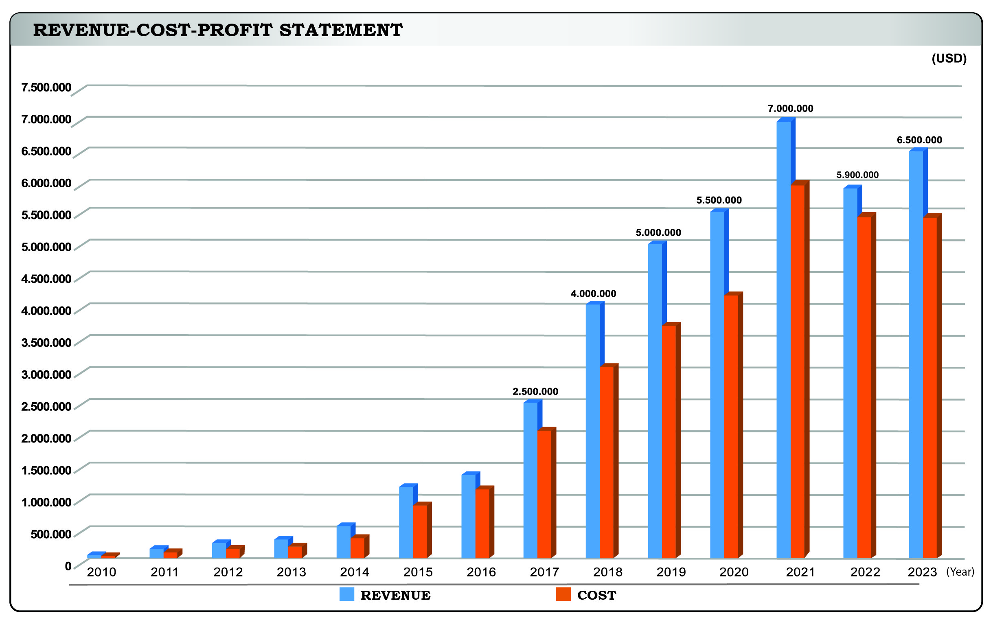
MARKETS AND YEARLY REVENUE
Growth chart of revenue and profit for the period 2010 - 2022

Slide 12
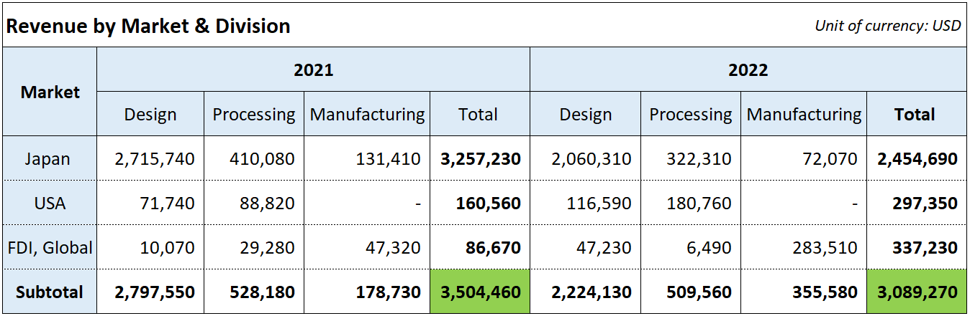
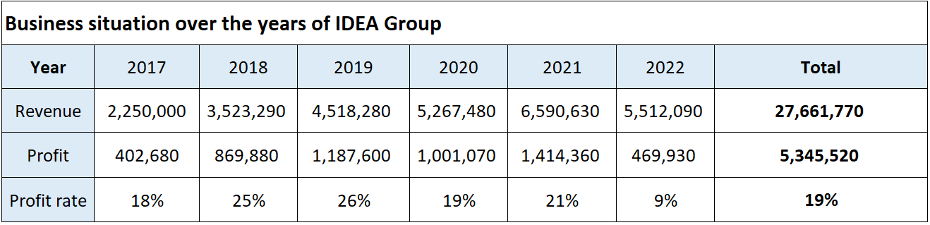
REVENUE STATISTICS

Slide 13
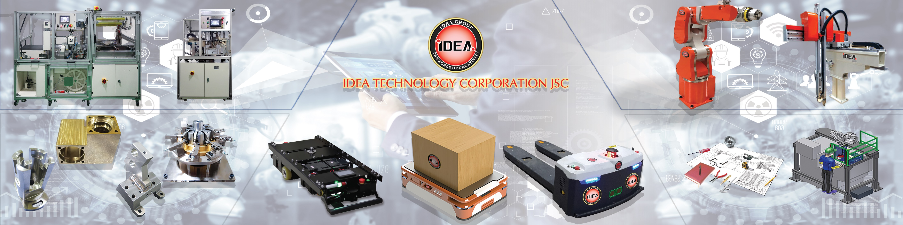
6. PRODUCTS AND SERVICES
1. Machine design contractor service
2. Automated machine manufacturing
3. Precision mechanical processing, jigs
4. Research and development of robots, AGVs
5. Trading, technical services and training

Slide 14
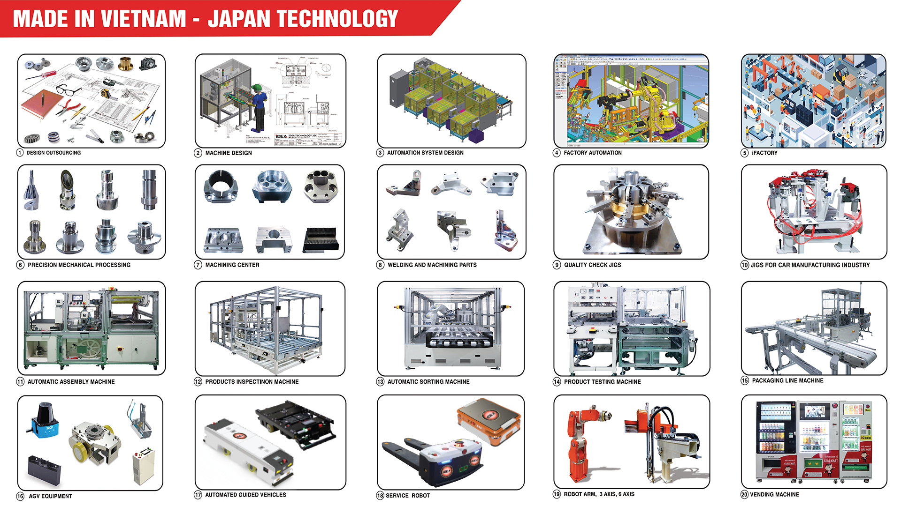

Slide 15
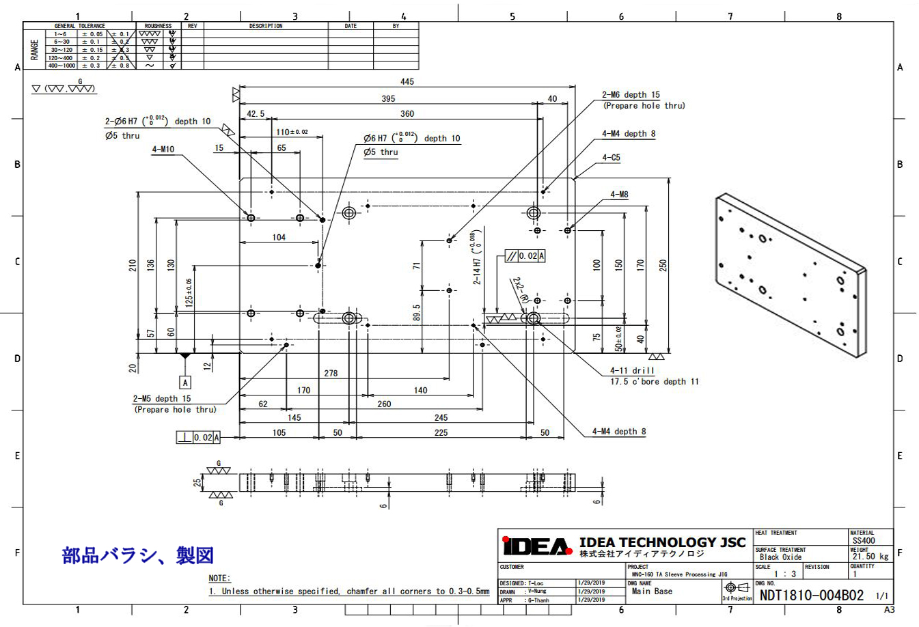
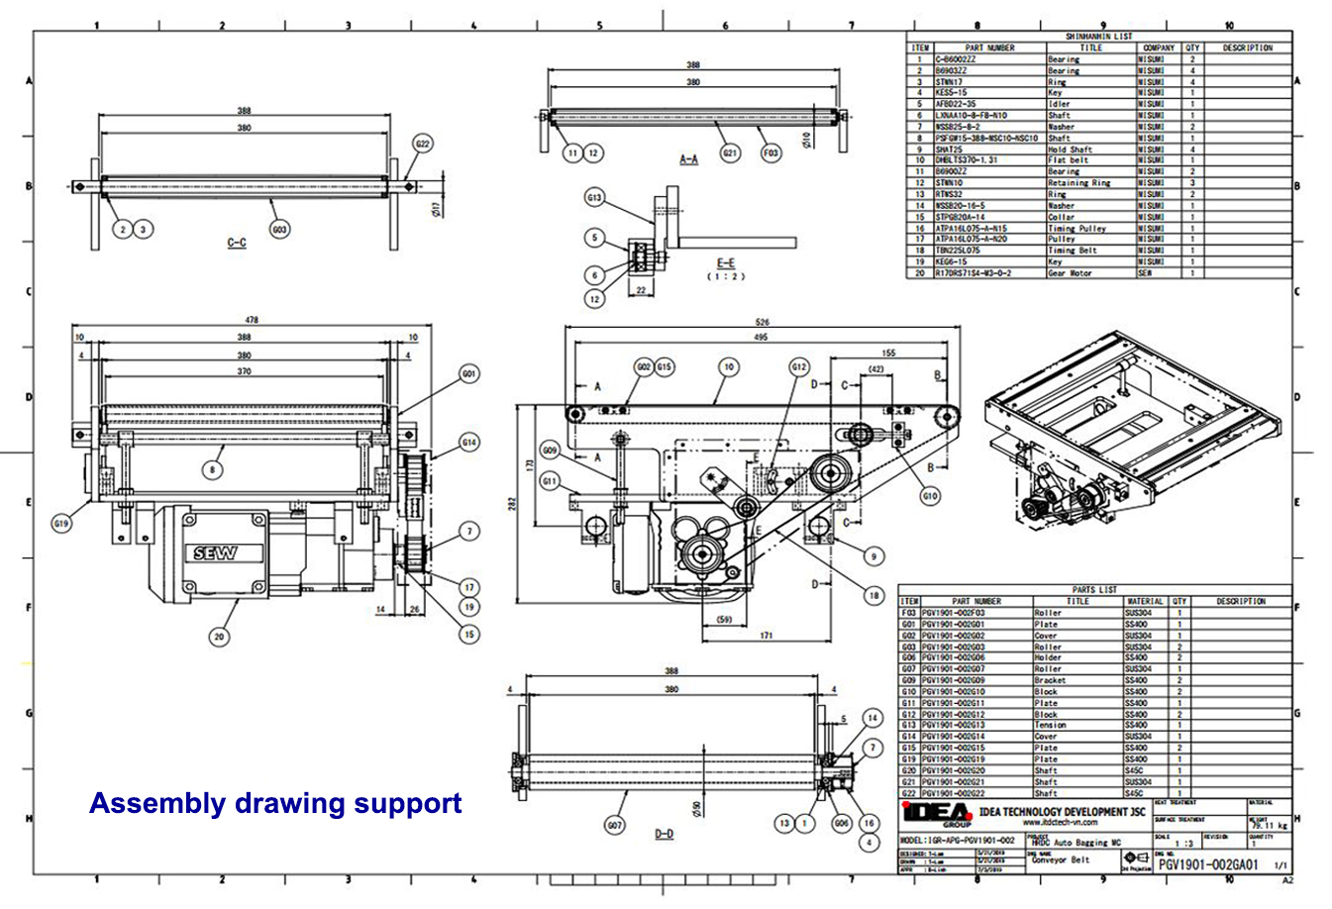
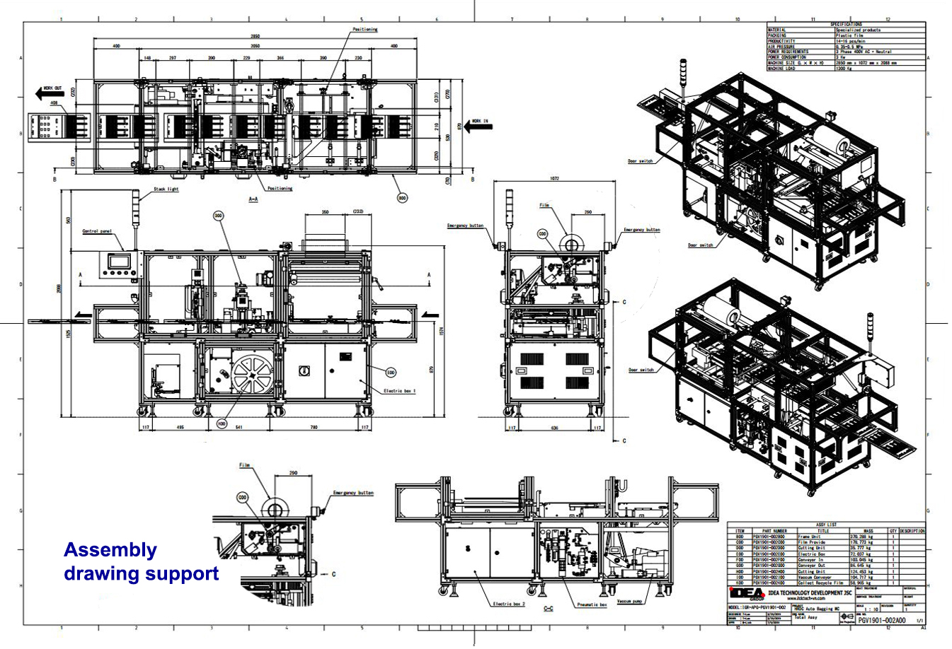
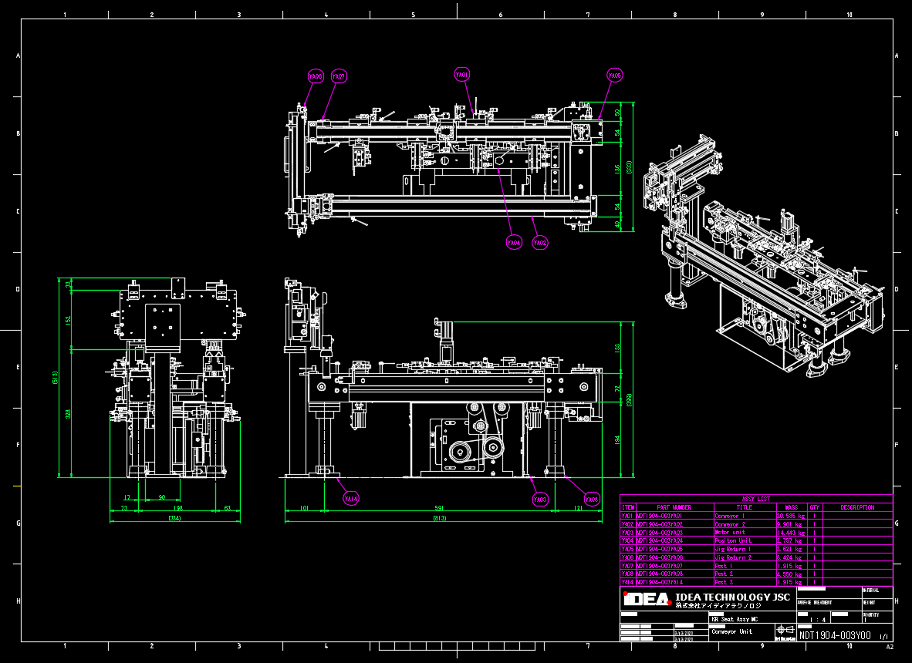
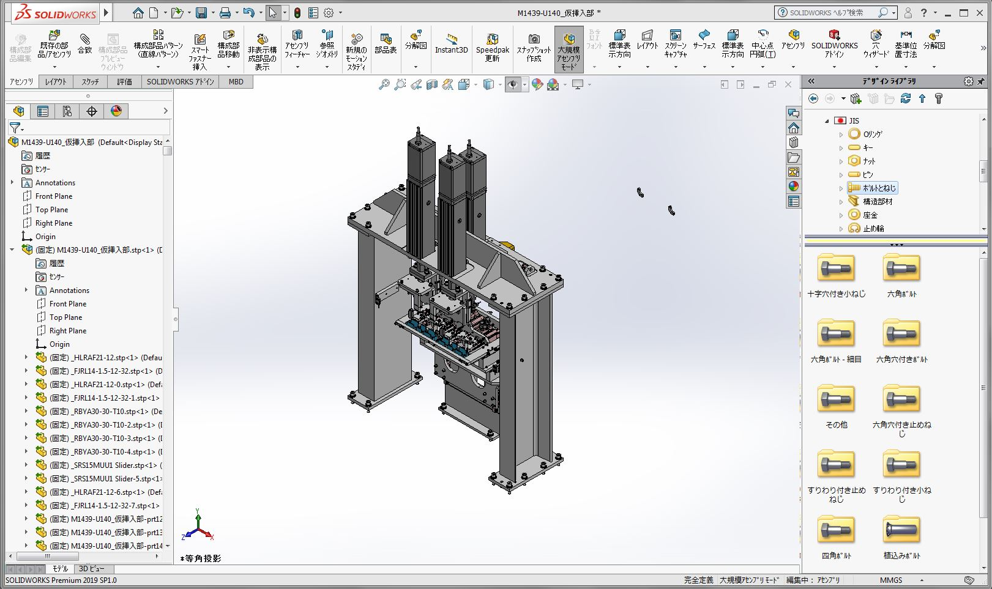
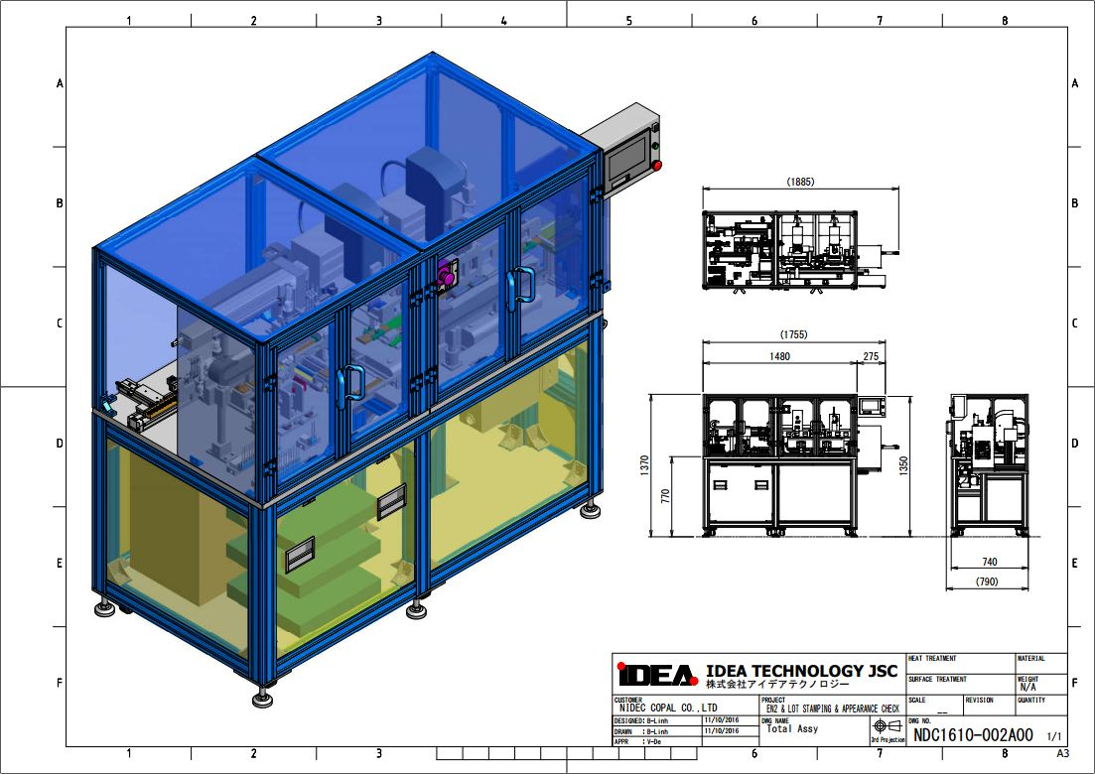
6.1. MACHINE DESIGN CONTRACTOR SERVICE
Dismantle parts drawing
Create assembly drawing
Design 2D machine
Process 2D drawing
Create 3D data
Design 3D machine

Slide 16
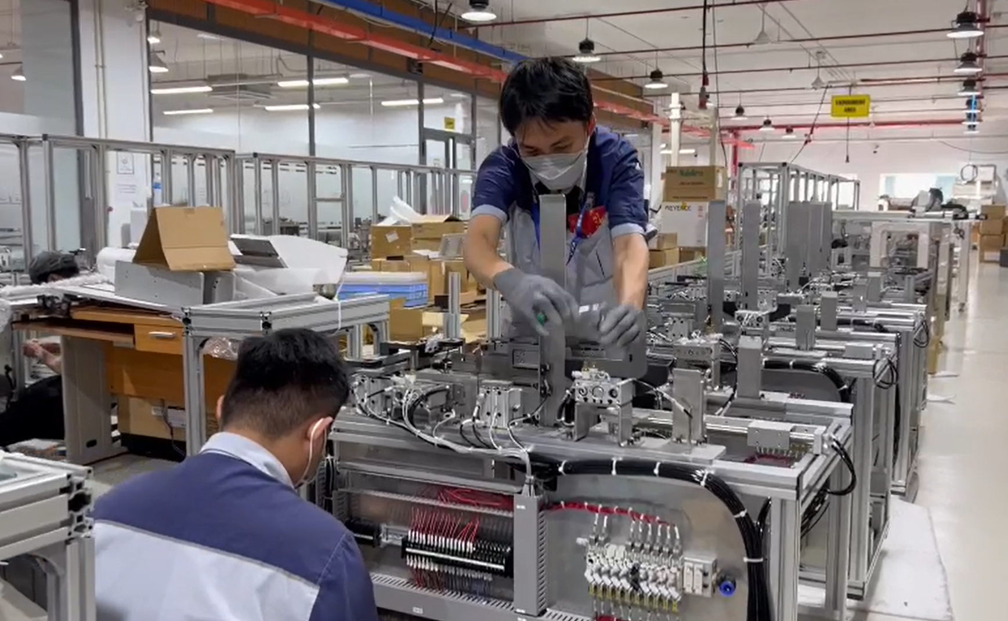
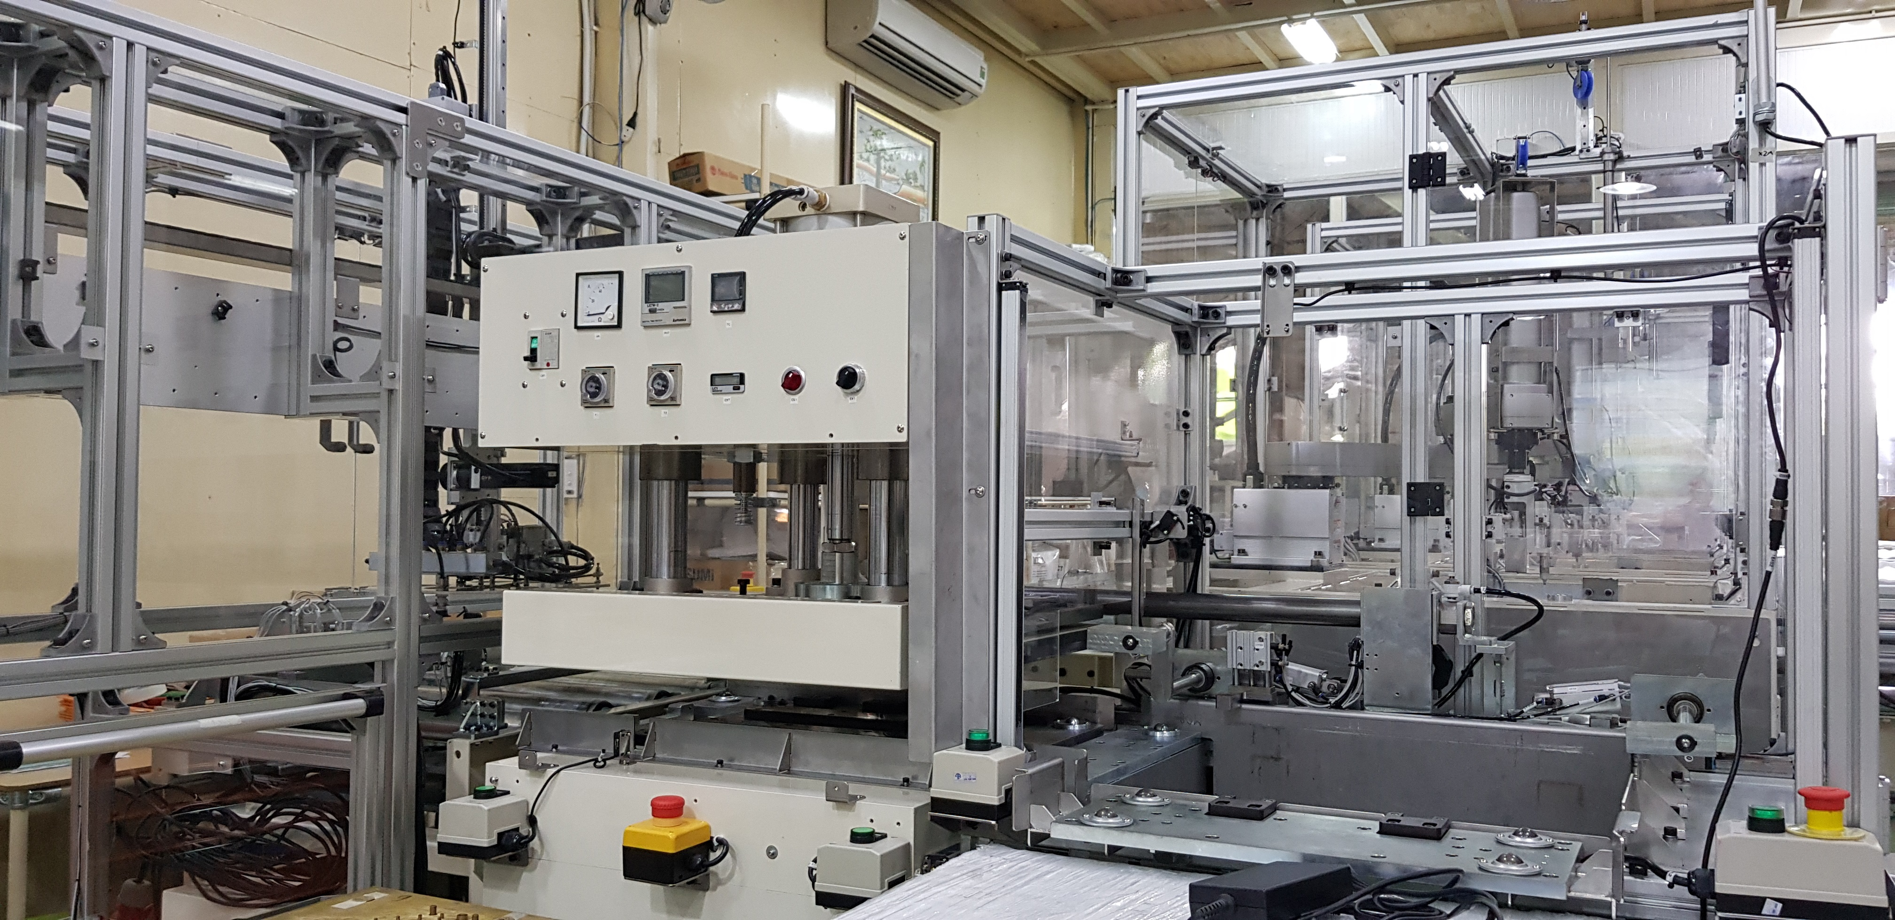
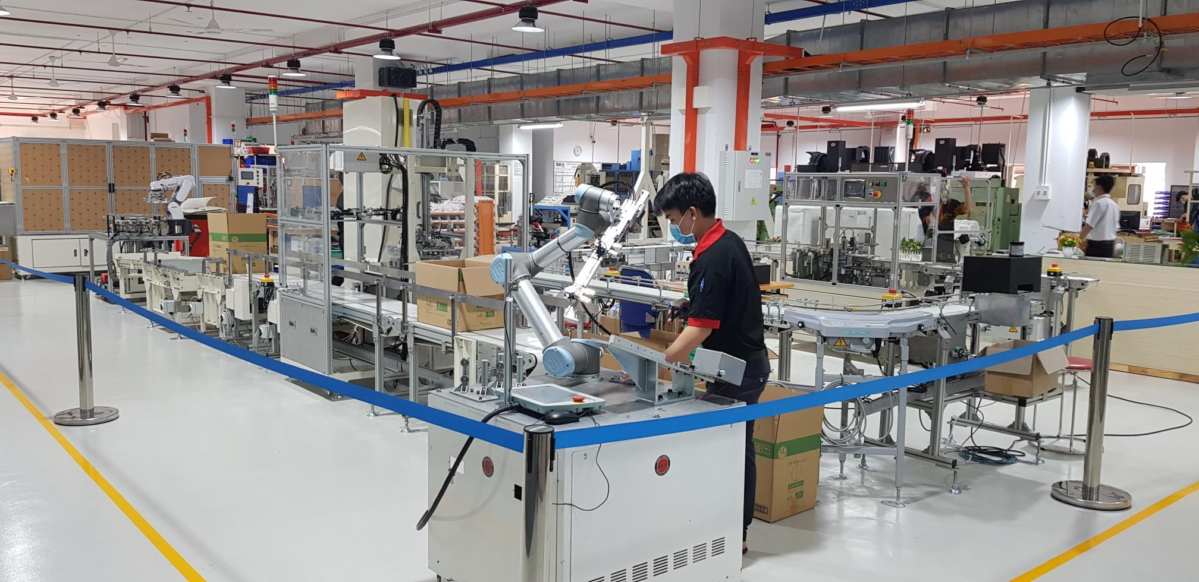
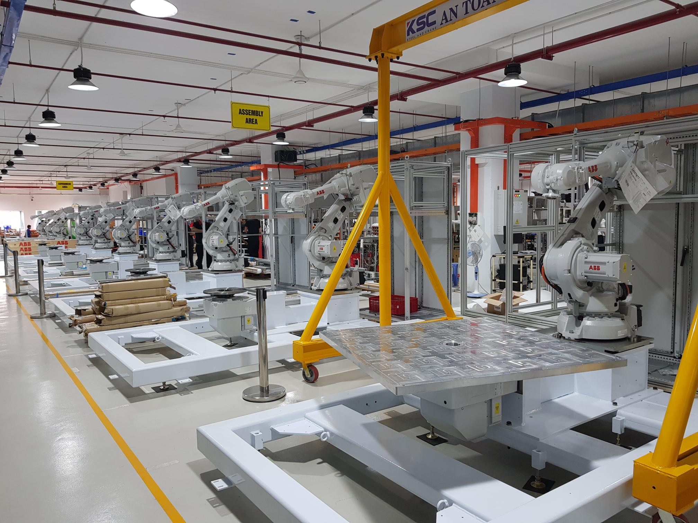
6.2. AUTOMATED MACHINE MANUFACTURING
Image of the assembly factory at Linh Trung 1 EPZ, Ho Chi Minh City

Slide 17
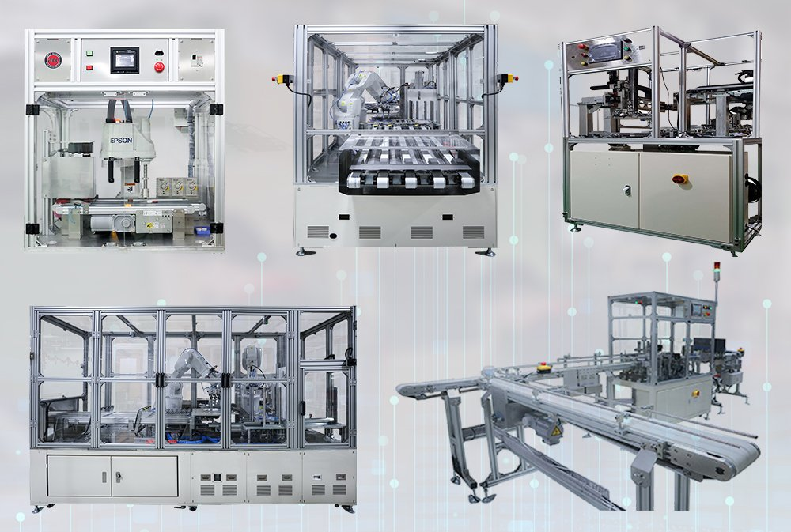
AUTOMATED MACHINES
Automated assembly machines
Automated sorting machine
Automated packaging machine

Slide 18
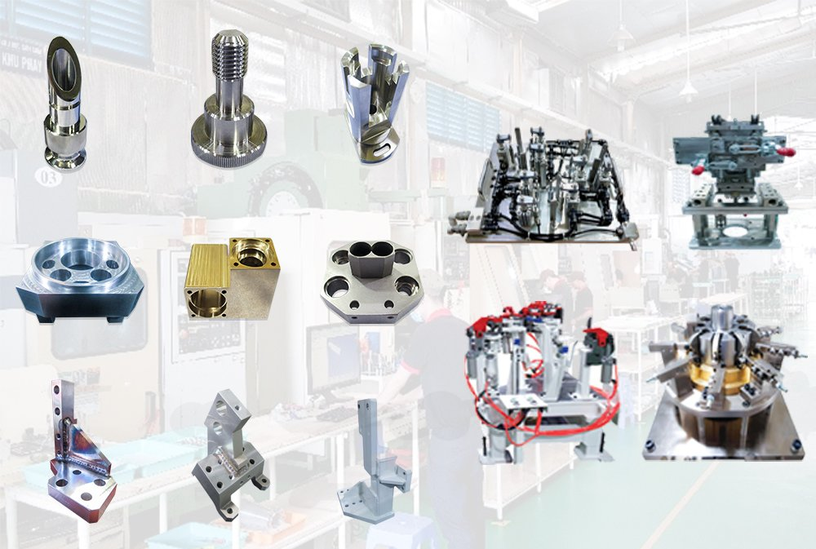
6.3. PRECISION MECHANICAL PROCESSING, JIGS
Lathe parts
Milling parts
Jigs for manufacturing
Welding parts

Slide 19
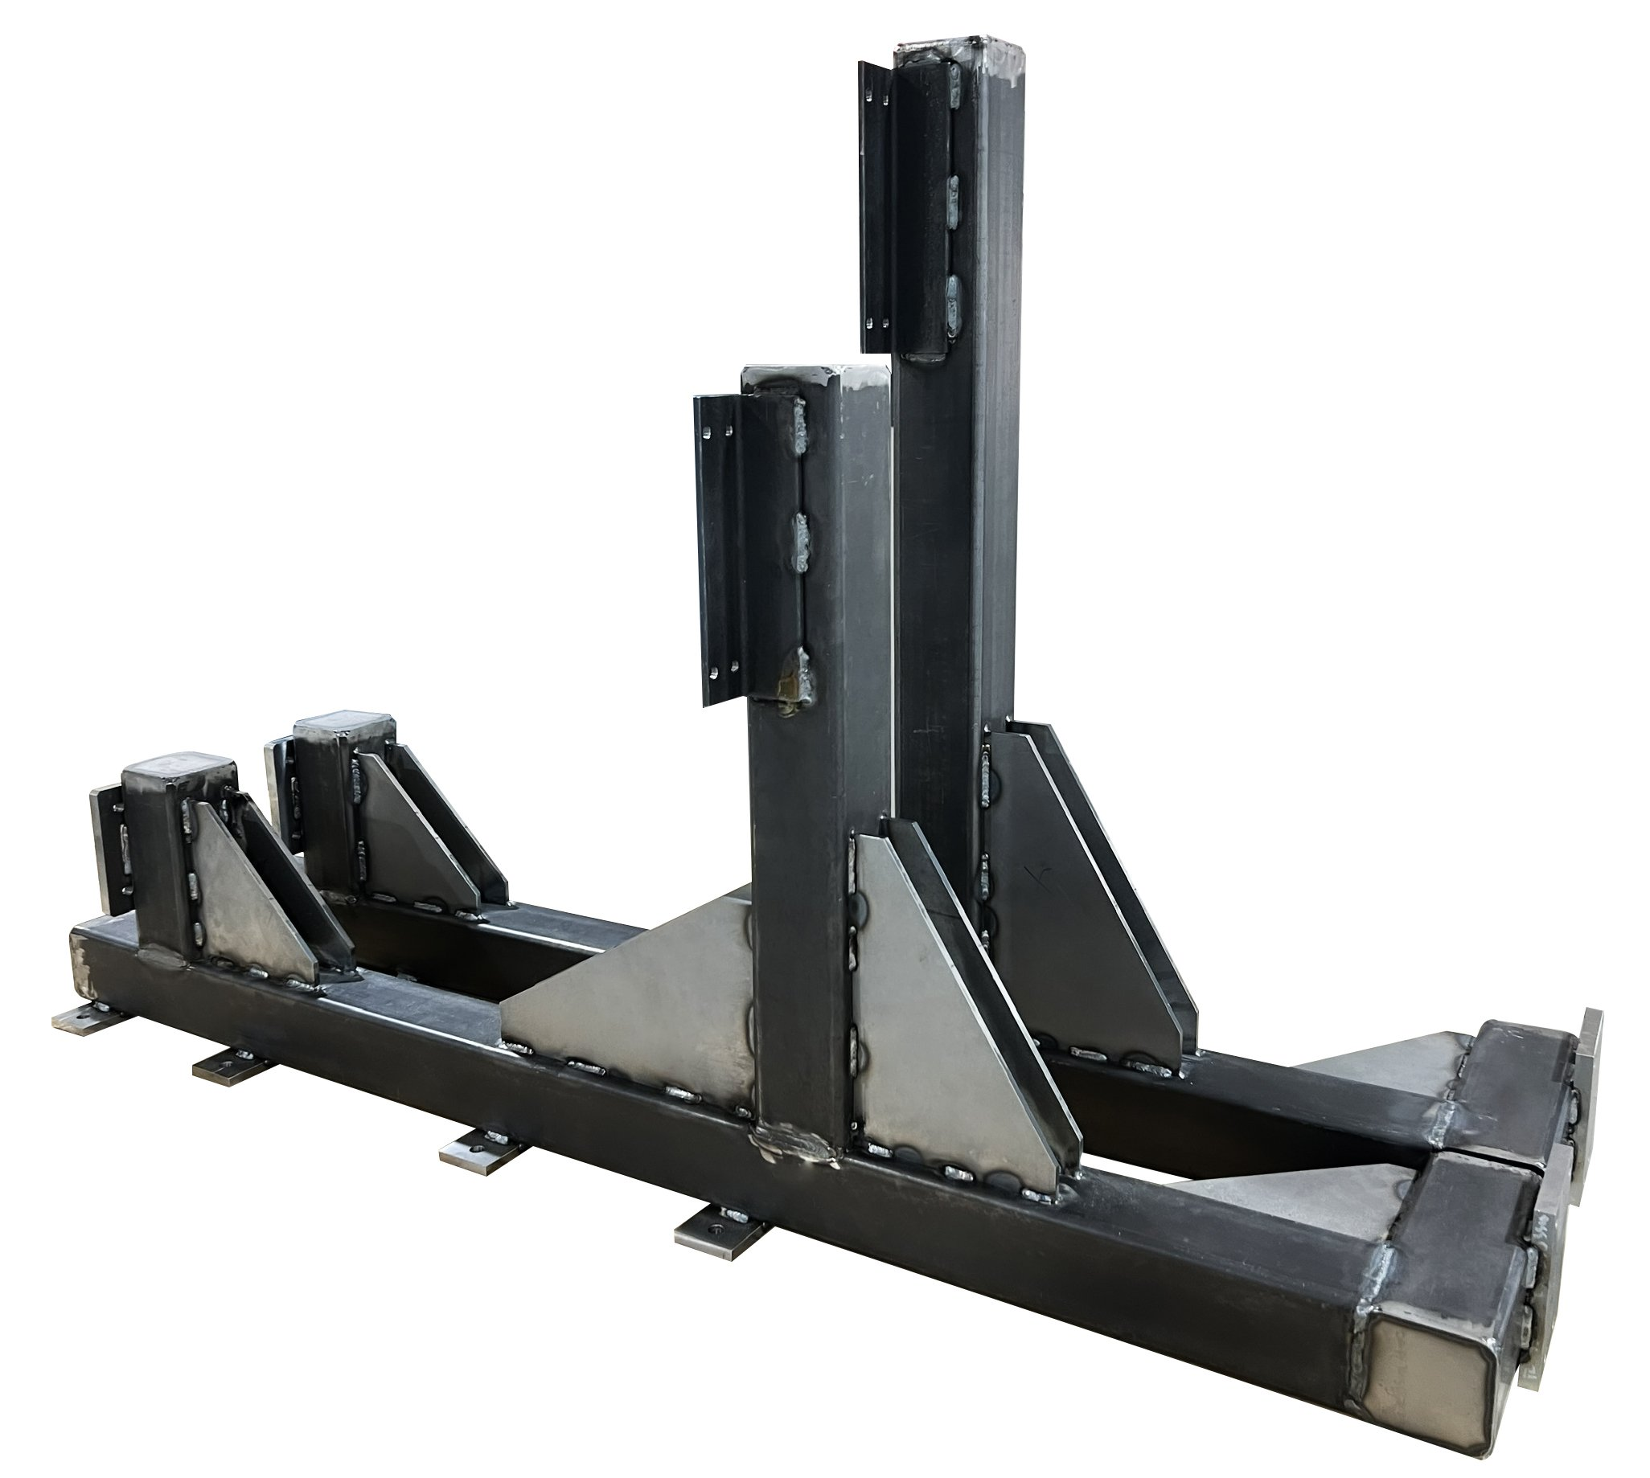
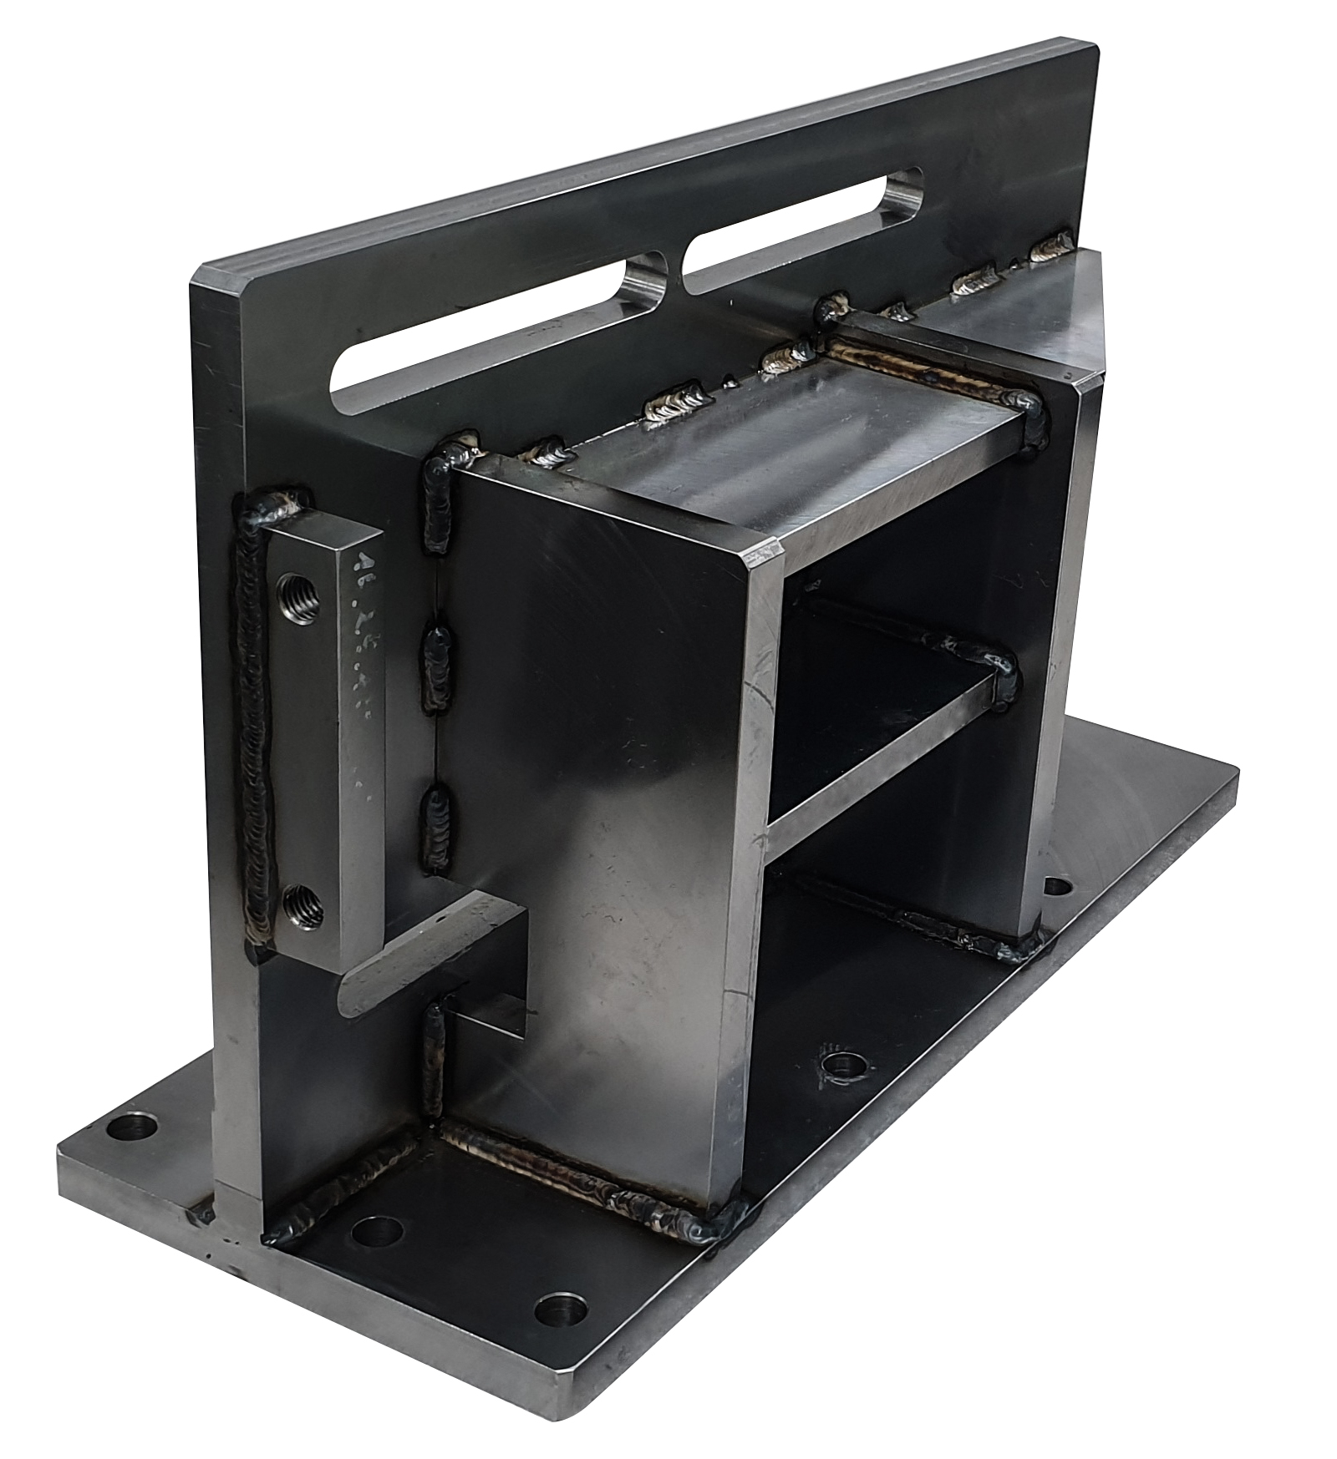
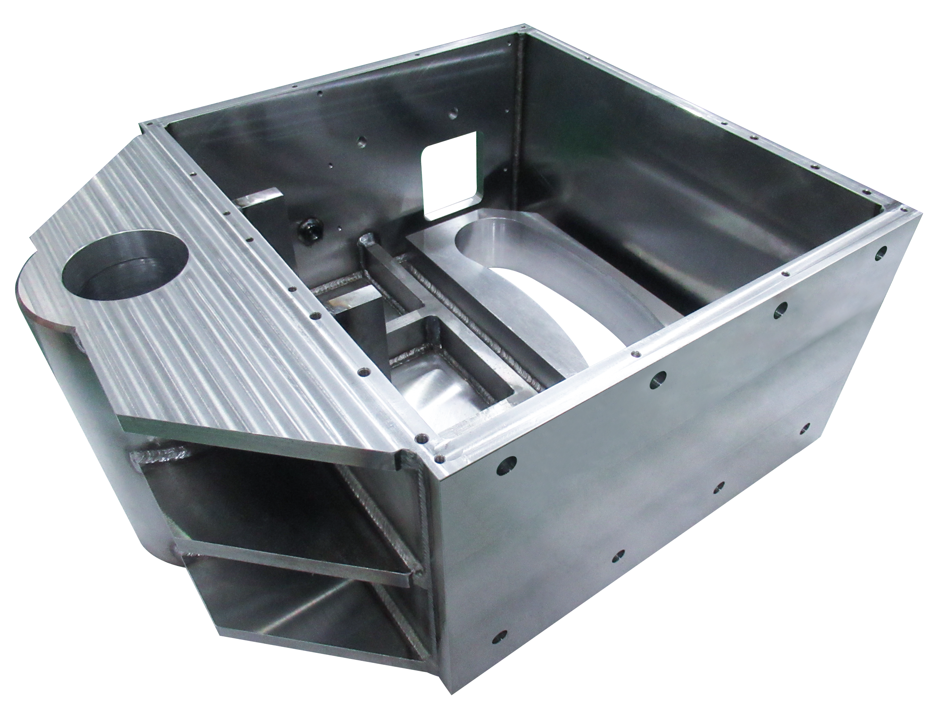
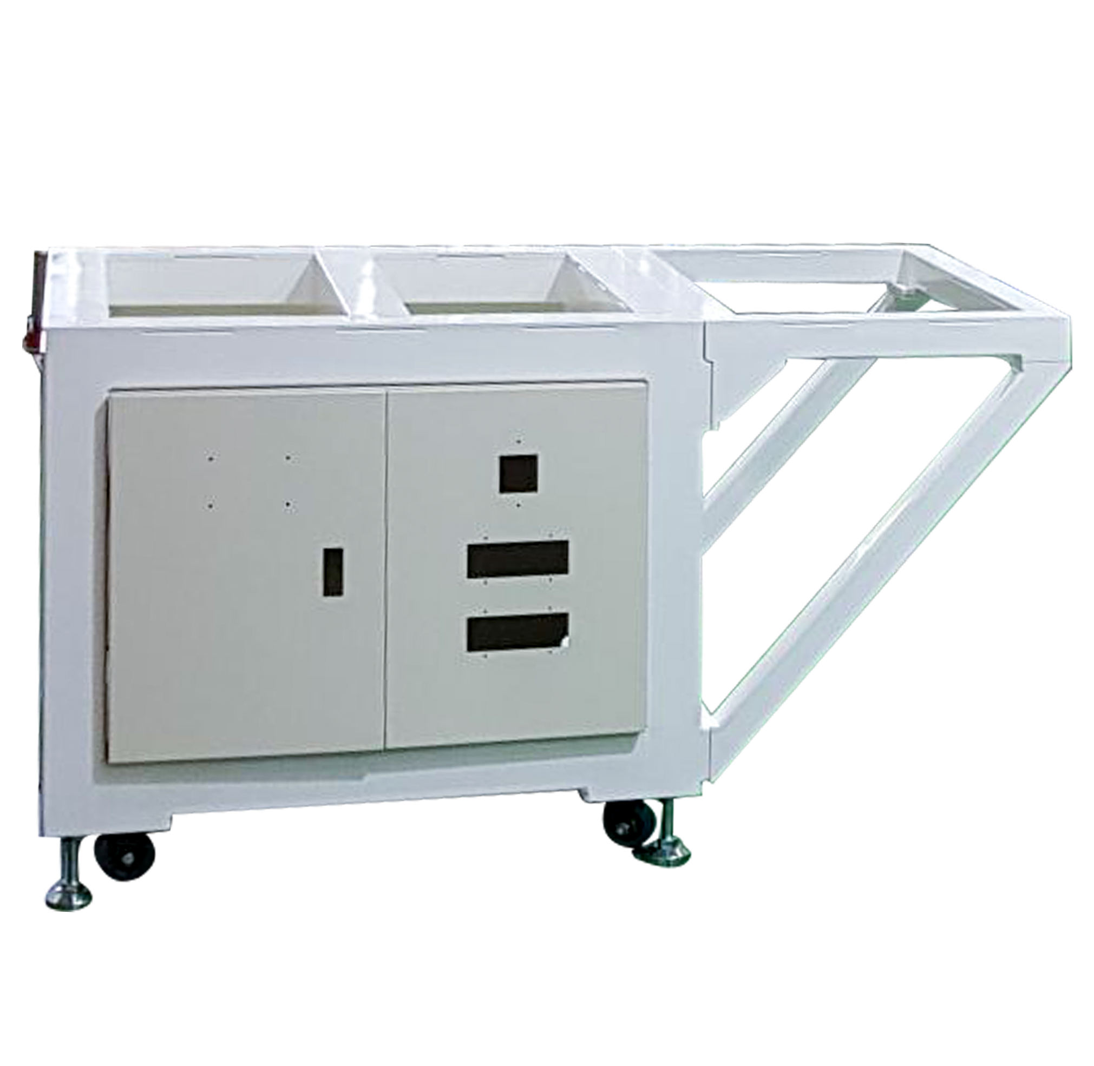
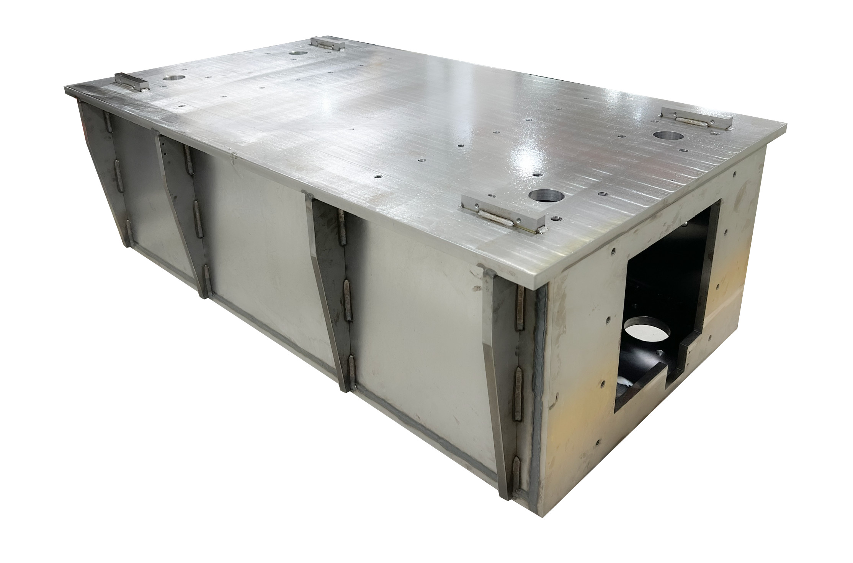
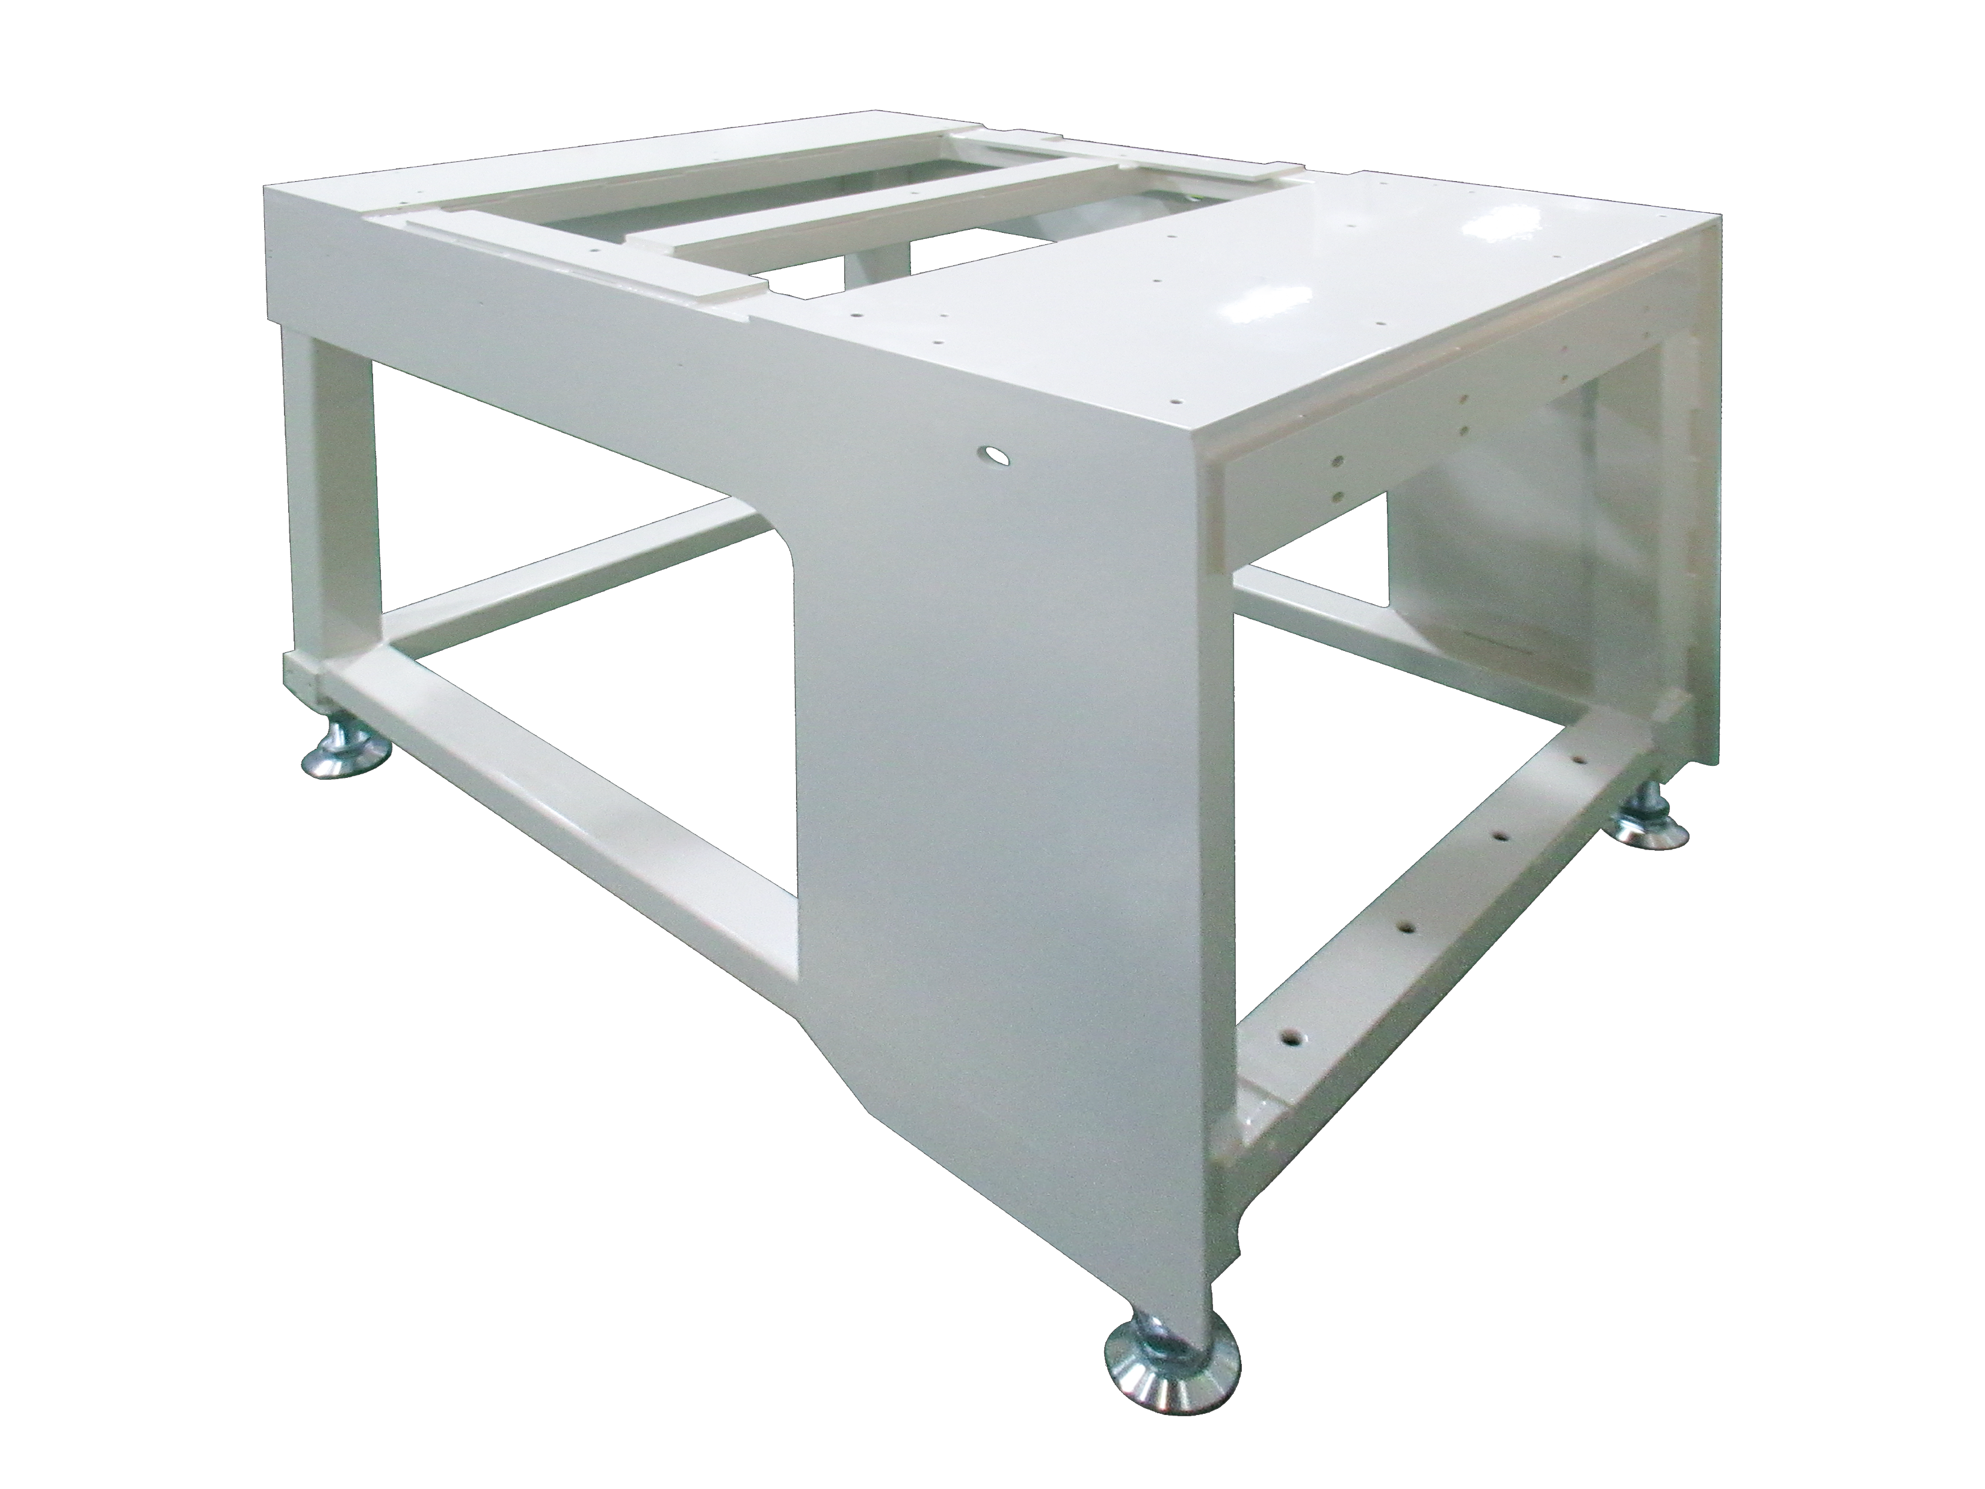
6.3. PRECISION MECHANICAL PROCESSING, JIGS
Welding frame
Machine frame

Slide 20
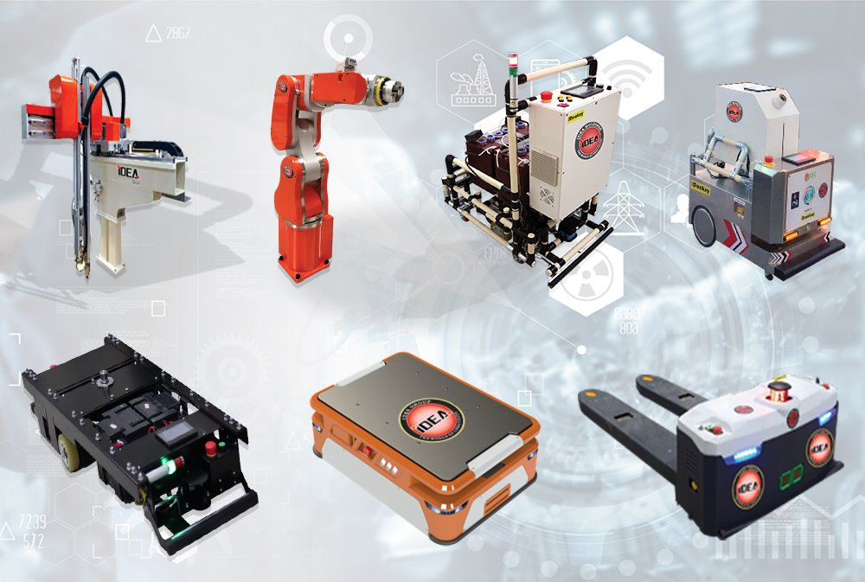
6.4. RESEARCH AND DEVELOPMENT OF ROBOTS, AGVS
3-axis robot
6-axis robot
AGV kit
Disinfection AGV
AGV (Magnetic)
AMR (SLAM)
AGV (SLAM)

Slide 21
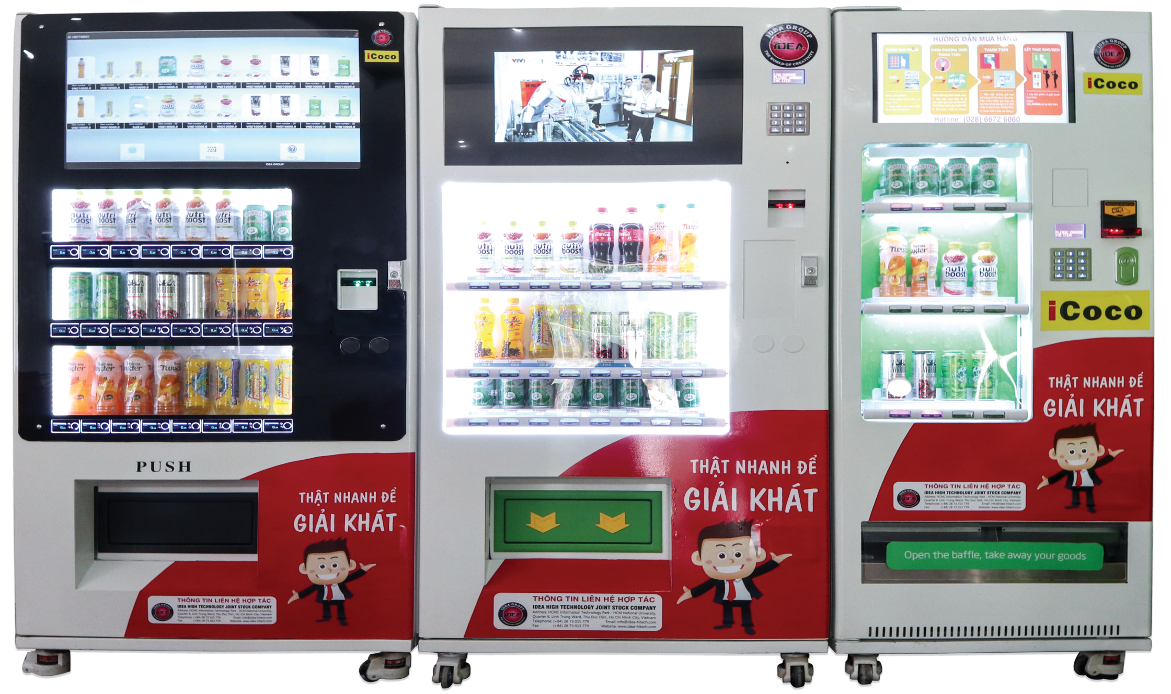
6.5. AUTOMATIC VENDING MACHINES

Slide 22
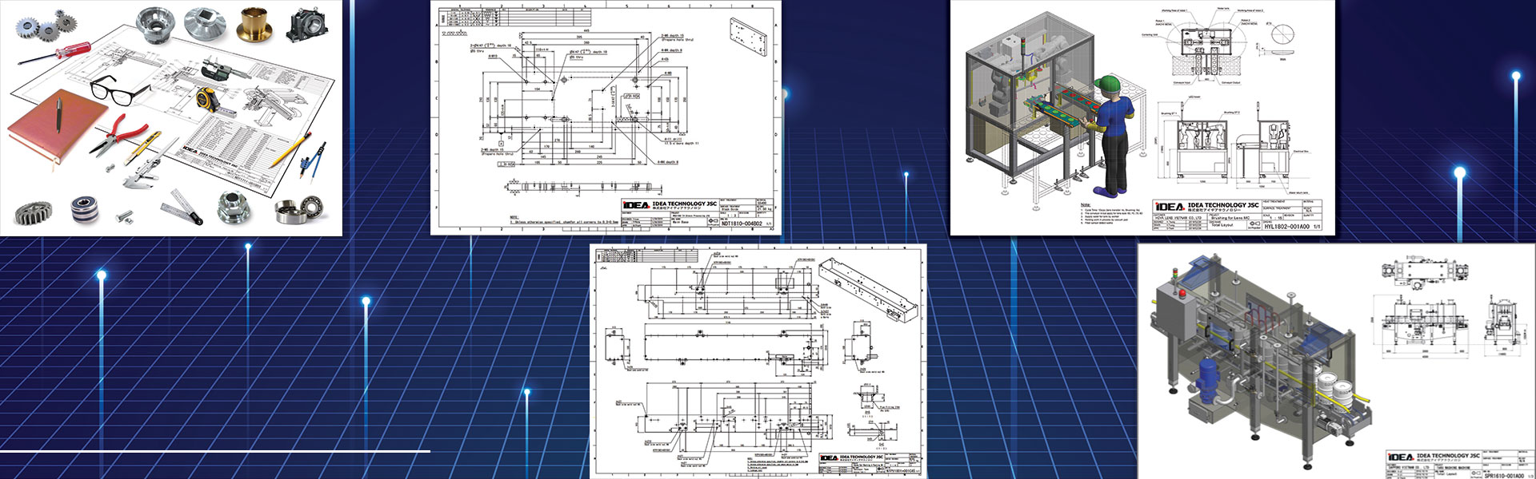
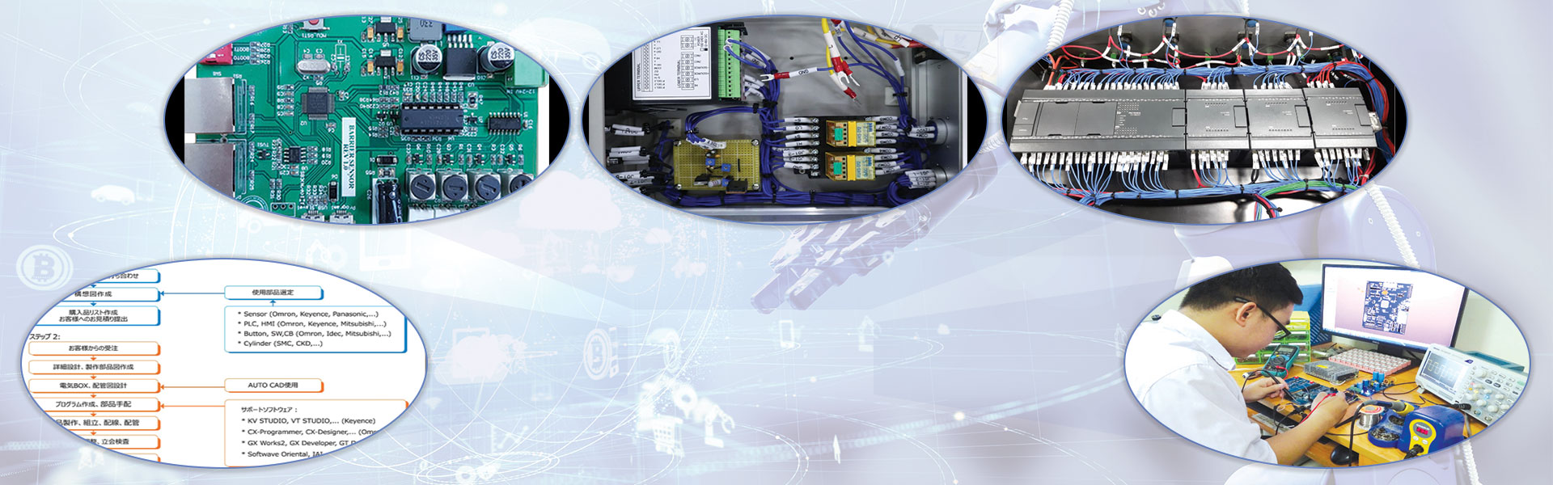
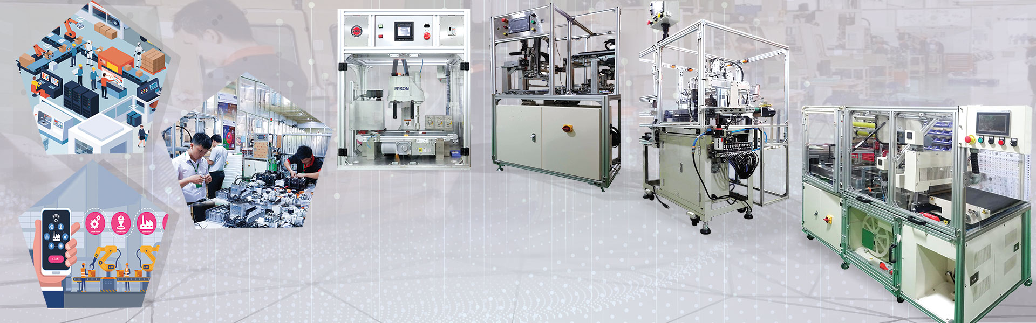
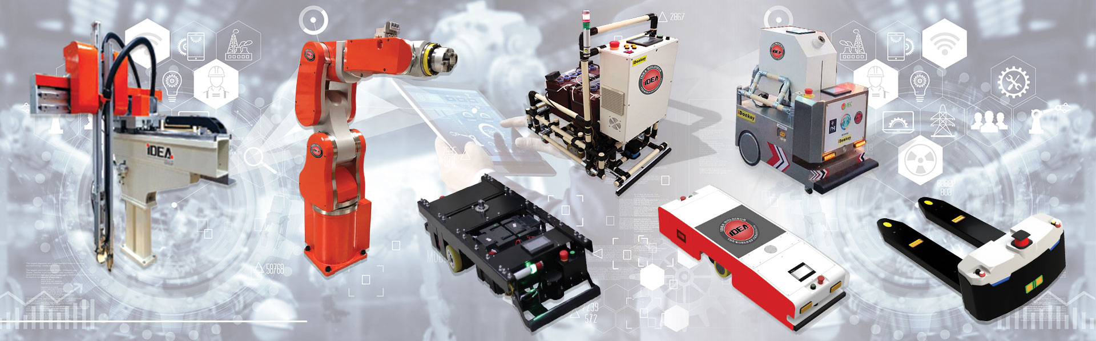
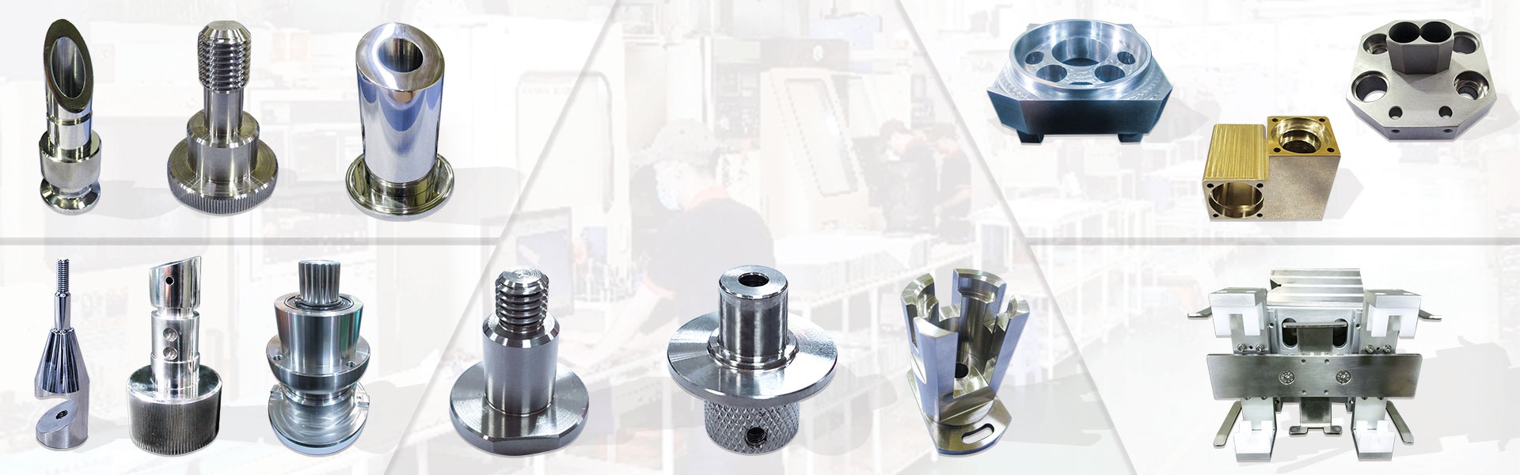

6.6. TRADING, TECHNICAL SERVICES AND TRAINING
Mechanical design service
Electrical design service
Machine manufacturing service
Commercialization of robots, AGVs
Mechanical processing service
Maintenance, export - import

Slide 23
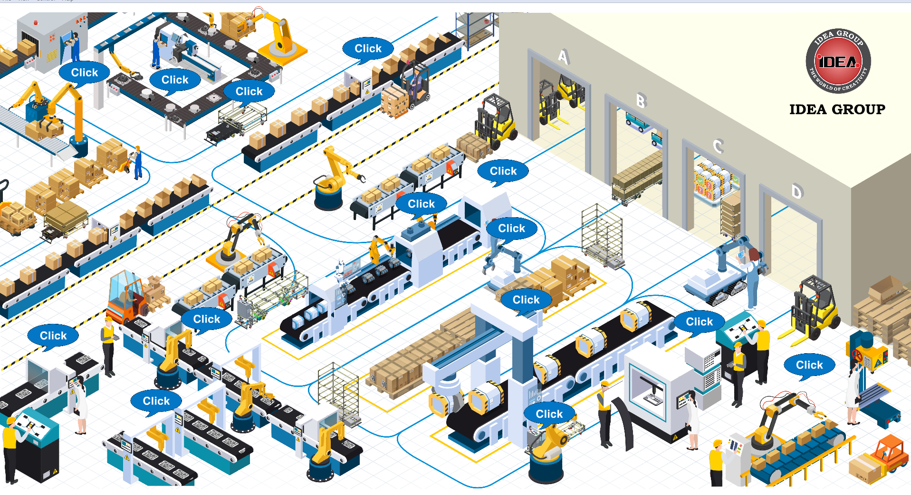
6.7. MANUFACTURING FACTORY AUTOMATION SYSTEM

Slide 24
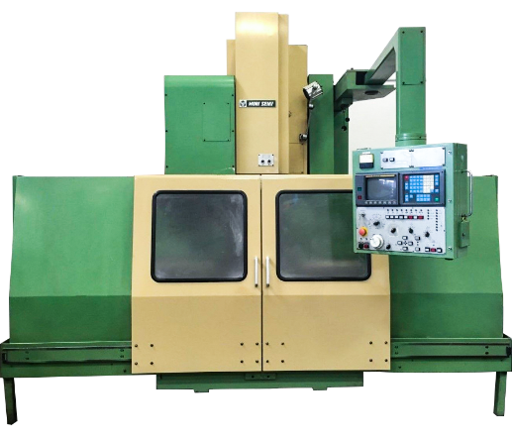
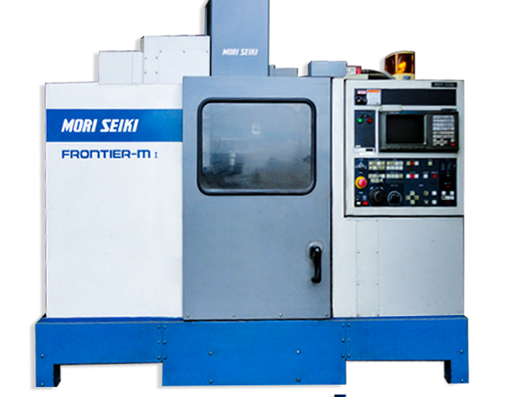
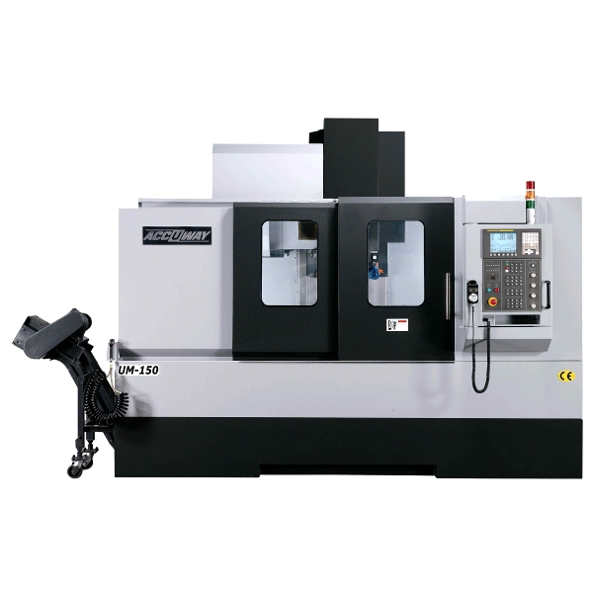
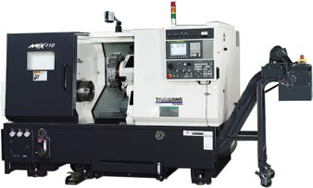
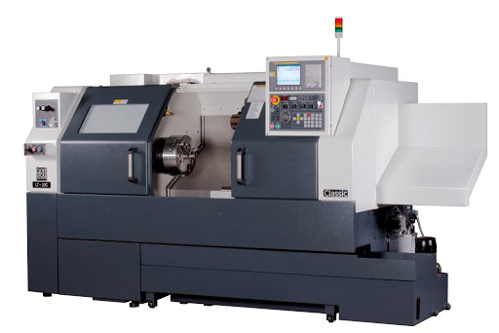
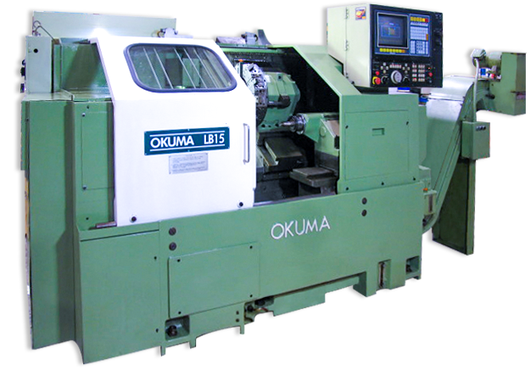
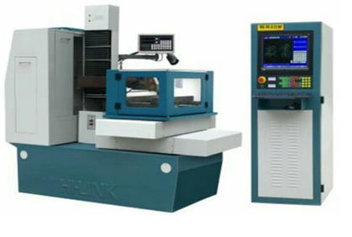
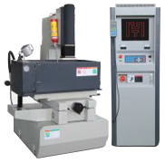
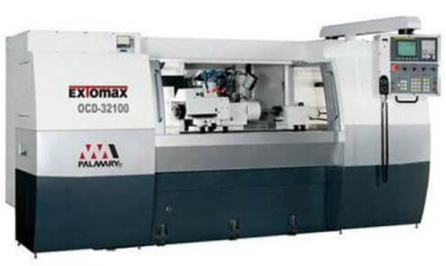
EQUIPMENT FOR PRODUCTION

Slide 25

7. CULTURAL ACTIVITIES

Slide 26




8. SENIOR LEADERS’ VISITS
Former Prime Minister - President Nguyen Xuan Phuc
Secretary of the City Party Committee
Consulate General of Japan

Slide 27











9. TYPICAL ACHIEVEMENTS

Slide 28
CERTIFICATE OF SCIENCE AND TECHNOLOGY ENTERPRISE
Manufacturing division ITDC
Design division ITEC

Slide 29

INTRODUCTION VIDEO

Slide 30


