Slide 1



IDEA TECHNOLOGY CORPORATION
ACHIEVEMENTS IN SCIENCE AND TECHNOLOGY

Slide 2

IDEA Group IDEA TECHNOLOGY CORPORATION JSC
PART 1:
INDUSTRIAL OWNERSHIP, COPYRIGHT

Slide 3

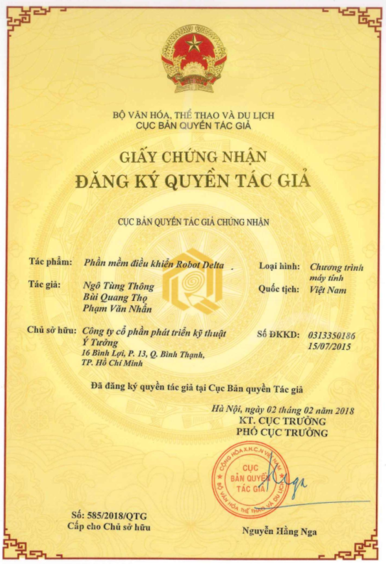
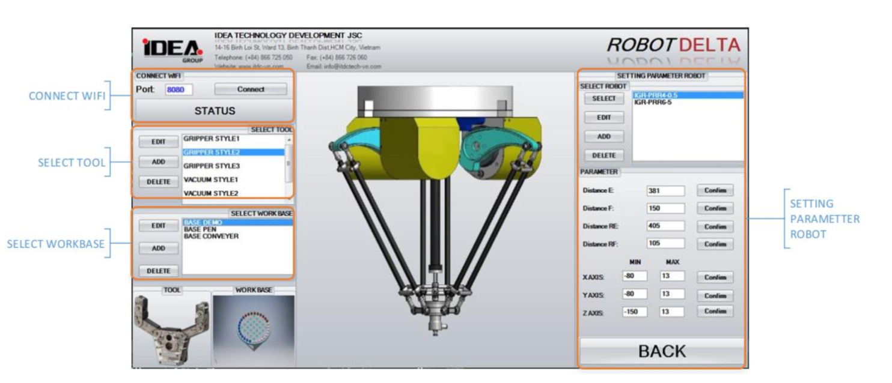
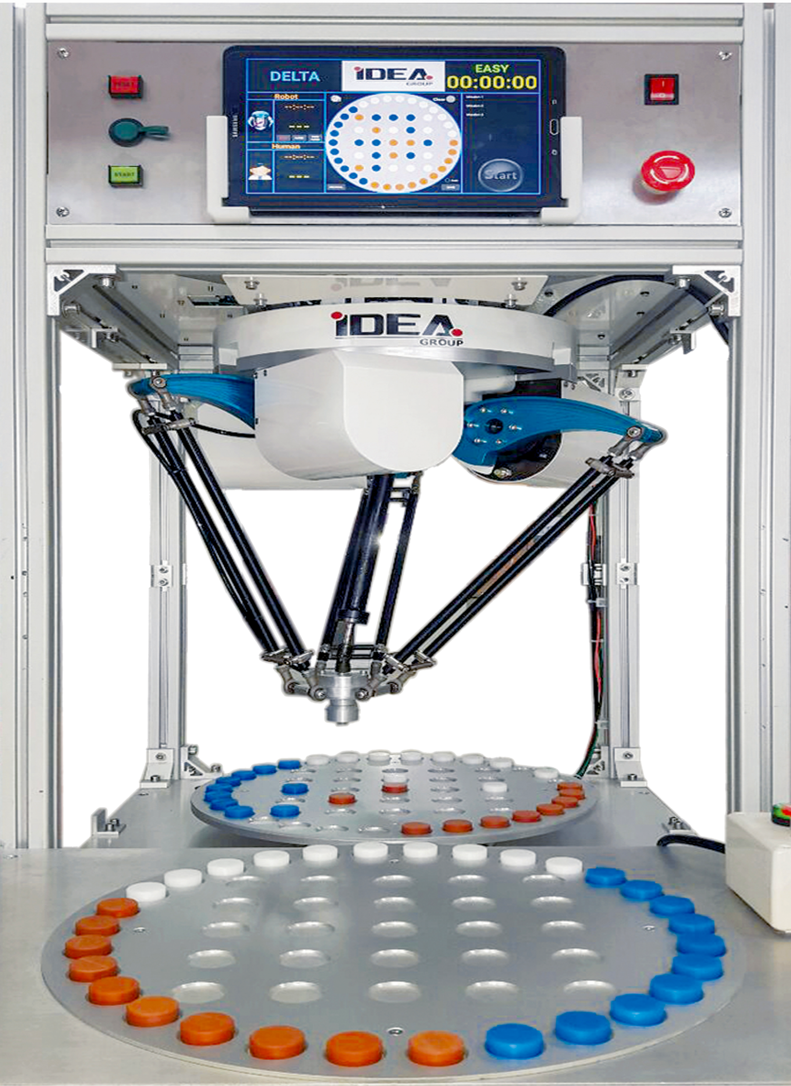
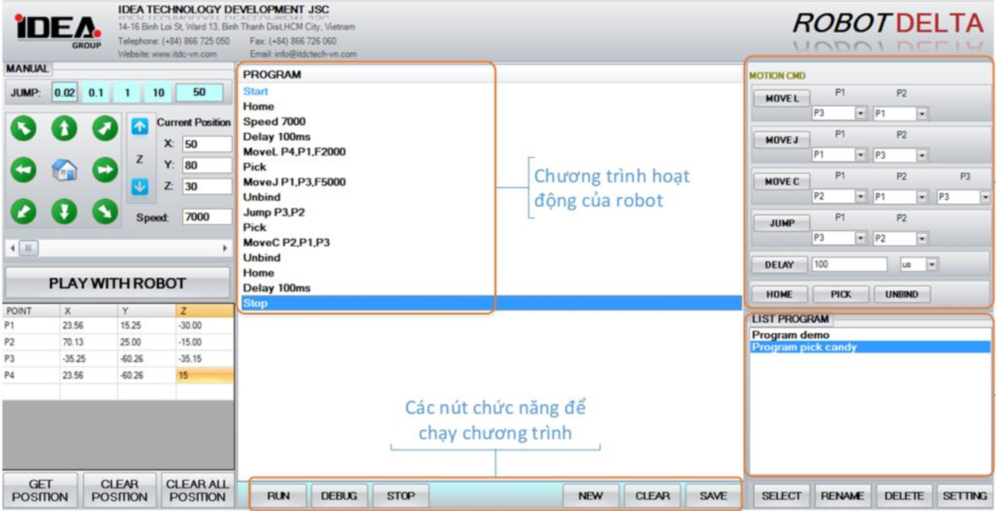
IDEA Group IDEA TECHNOLOGY CORPORATION JSC
CERTIFICATE OF
COPYRIGHT - DELTA ROBOT CONTROL SOFTWARE

Slide 4
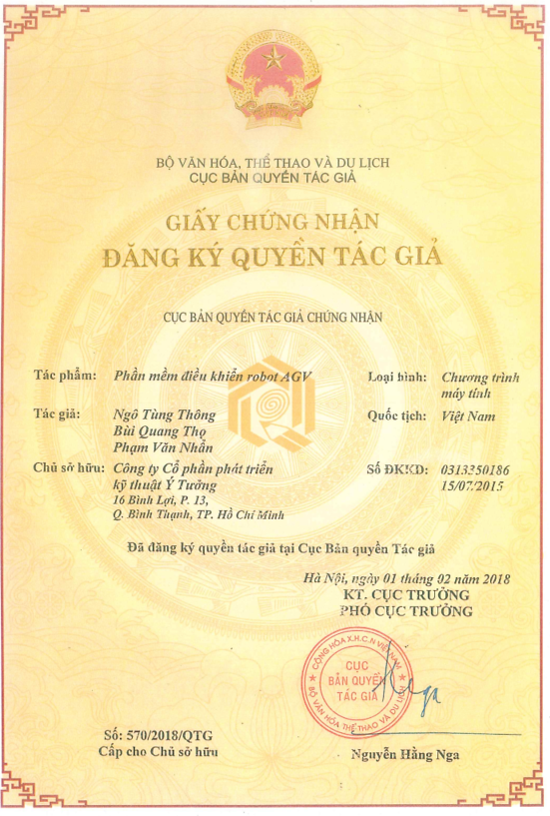
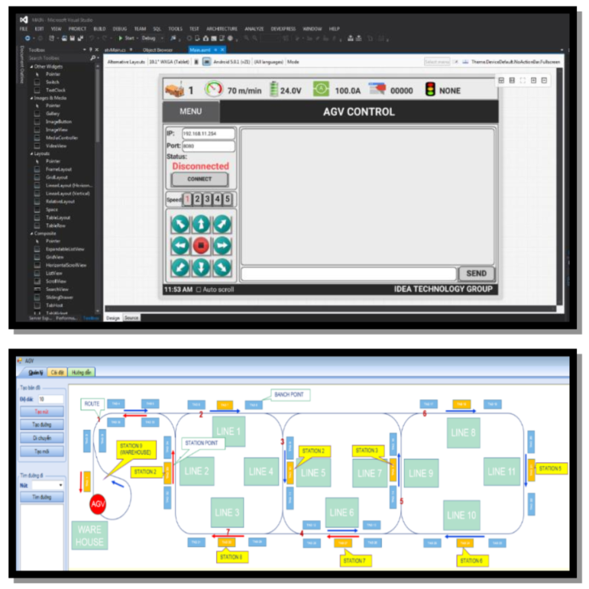
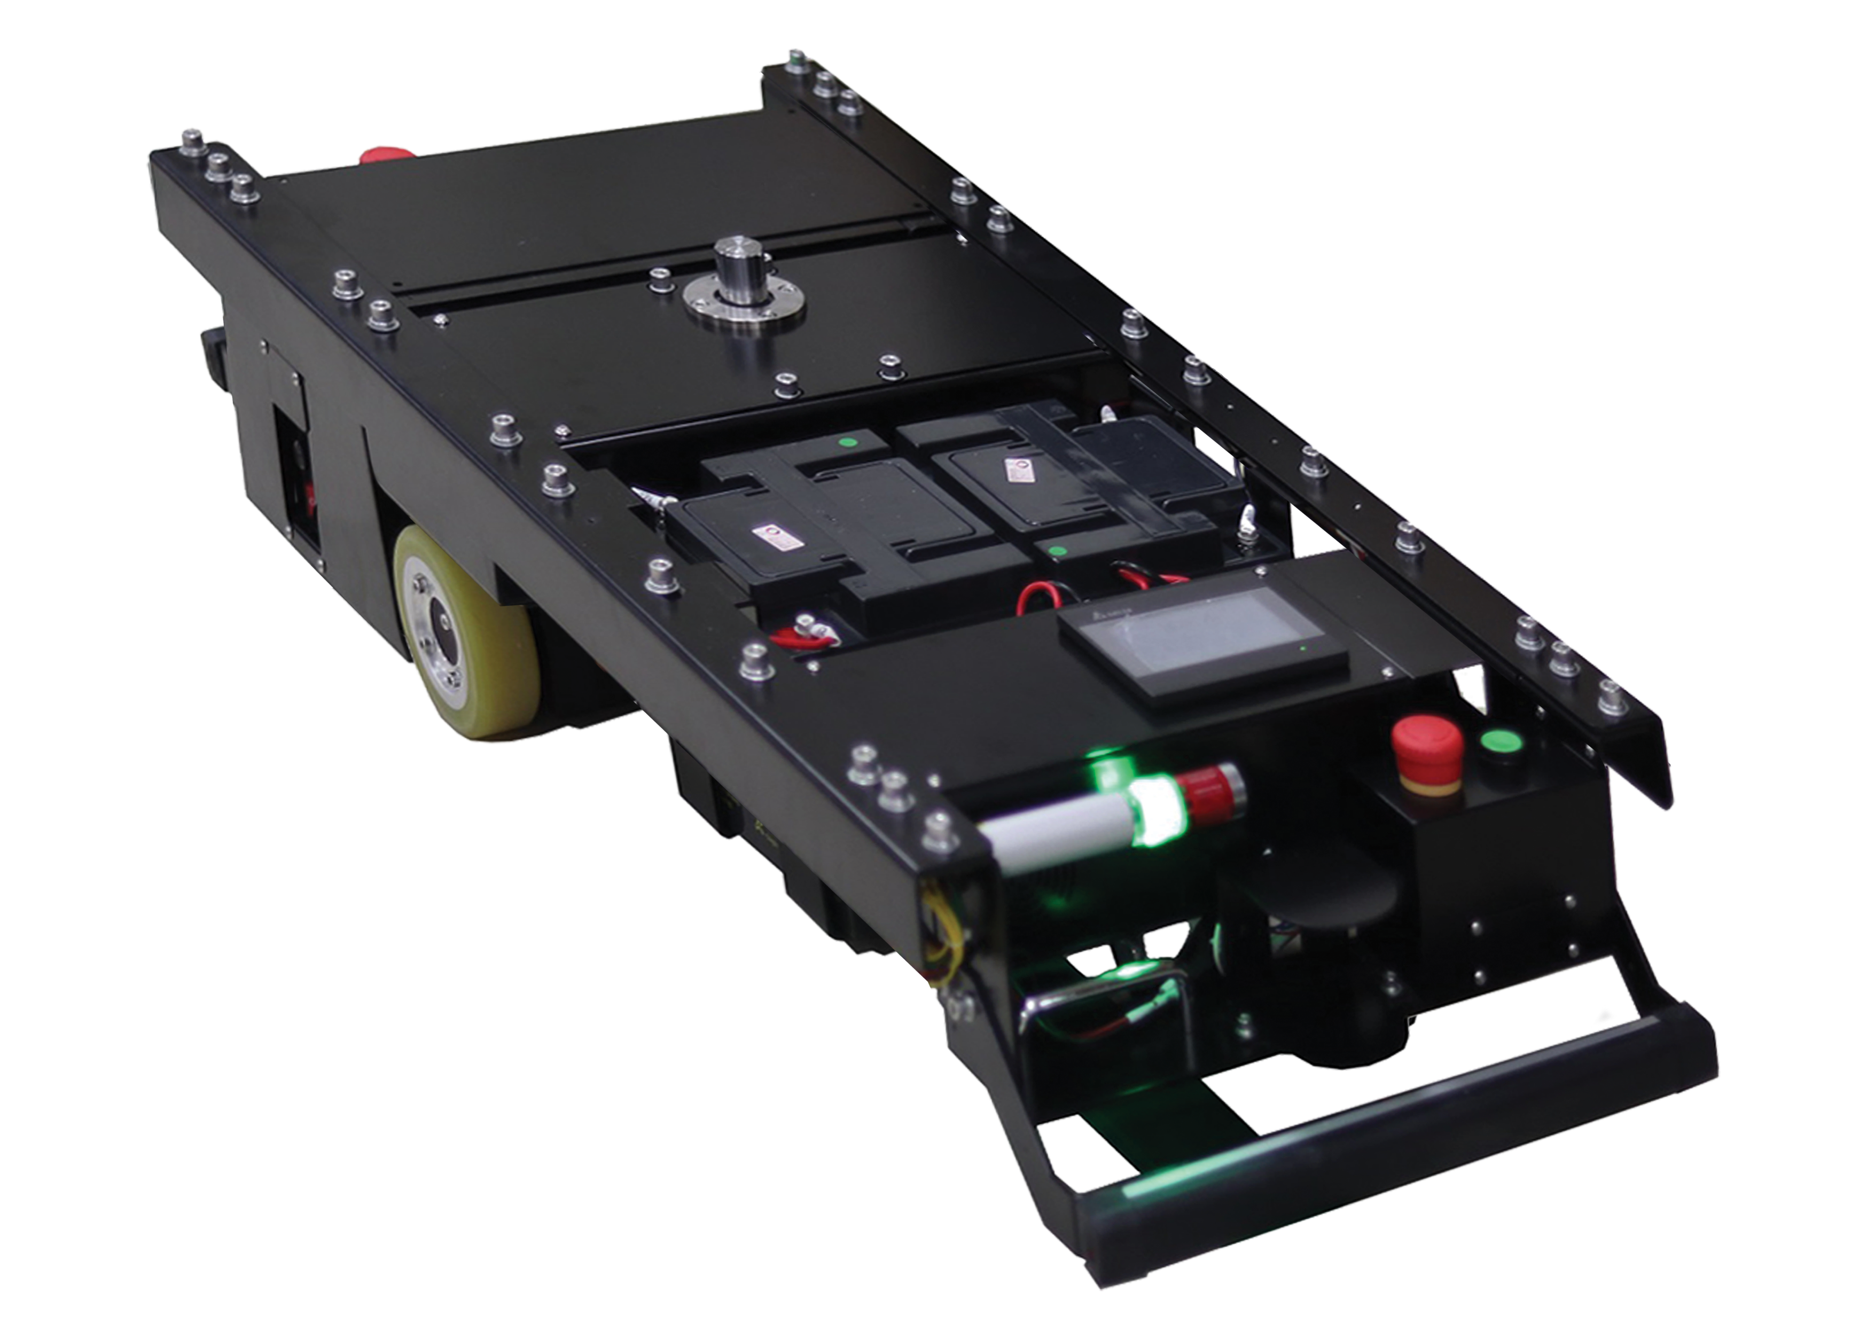
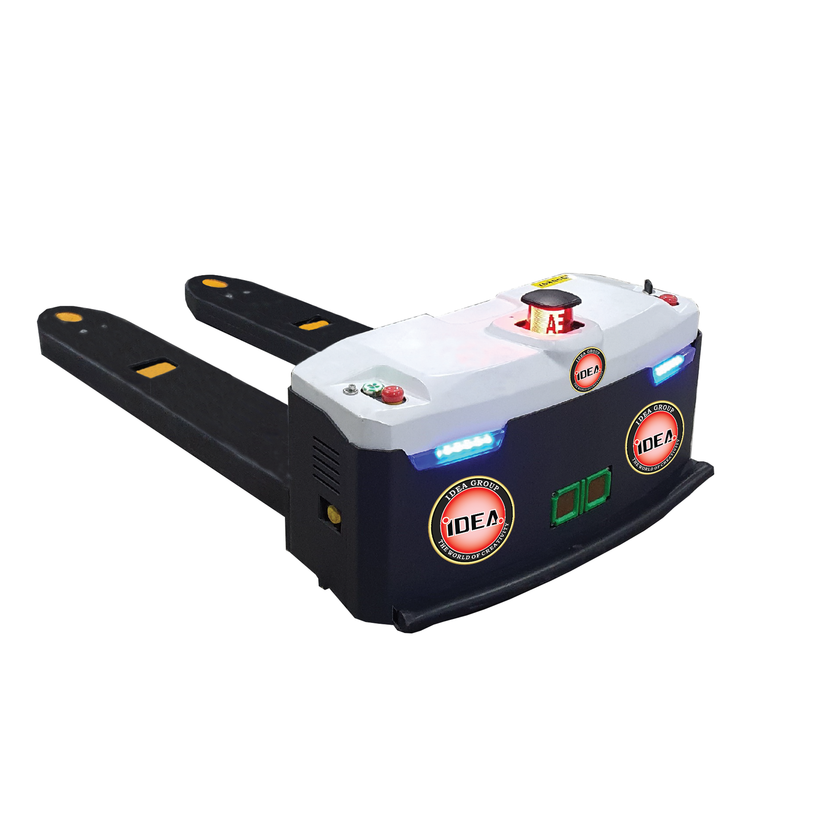
IDEA Group IDEA TECHNOLOGY CORPORATION JSC
CERTIFICATE OF
COPYRIGHT - AGV CONTROL SOFTWARE

Slide 5
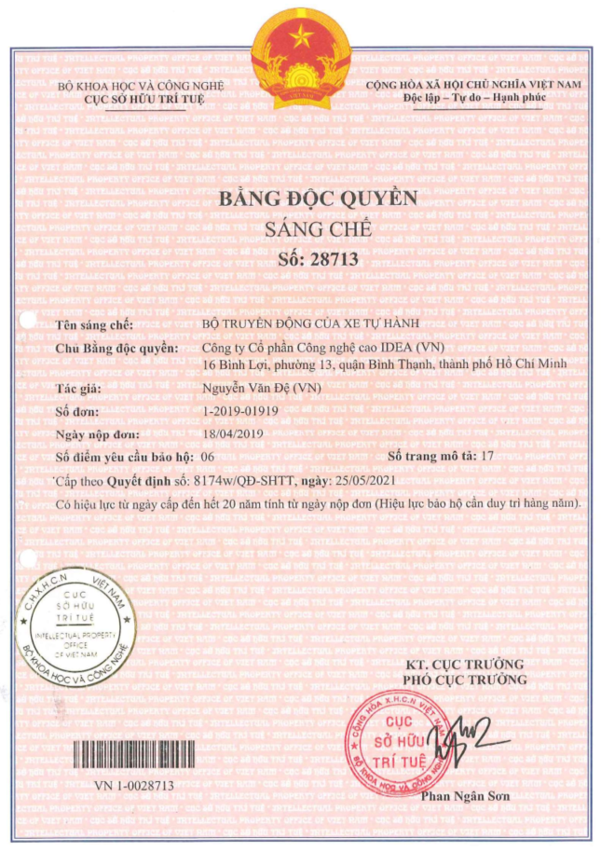
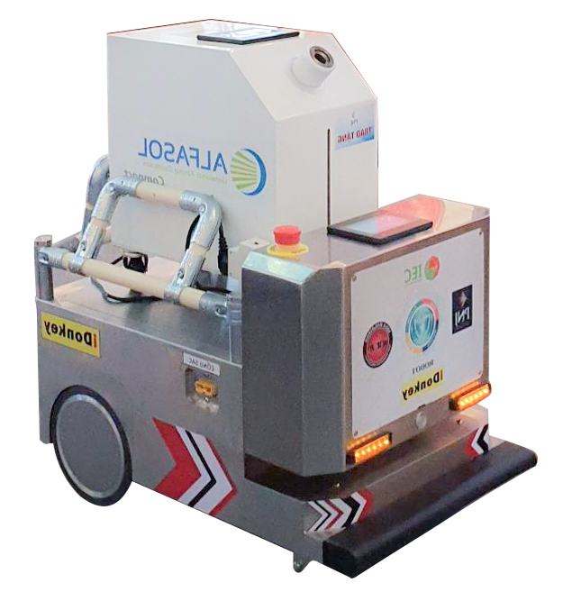
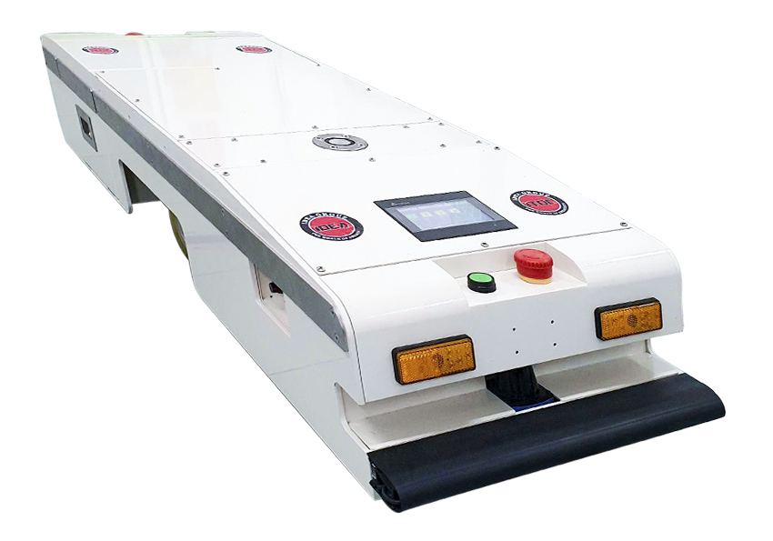
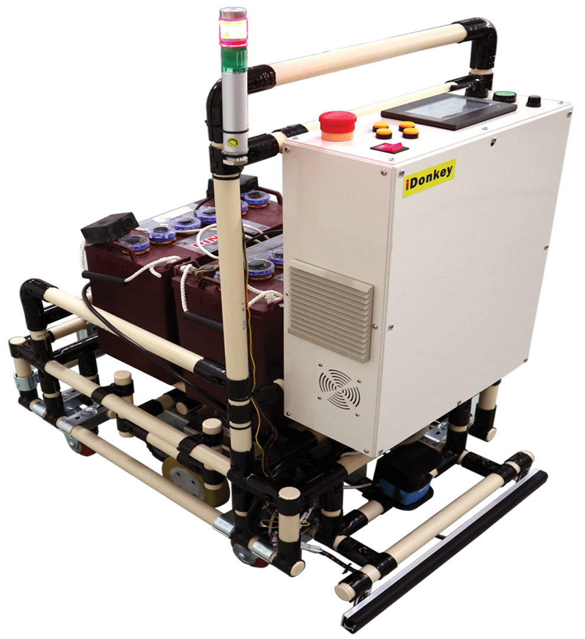

IDEA Group IDEA TECHNOLOGY CORPORATION JSC
EXCLUSIVE PATENT FOR AUTOMATED GUIDED VEHICLE (AGV) MOTION SYSTEM

Slide 6
IDEA Group IDEA TECHNOLOGY CORPORATION JSC
PART 2:
TRADEMARK

Slide 7
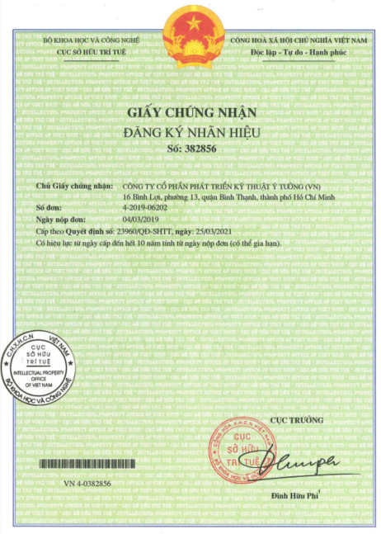
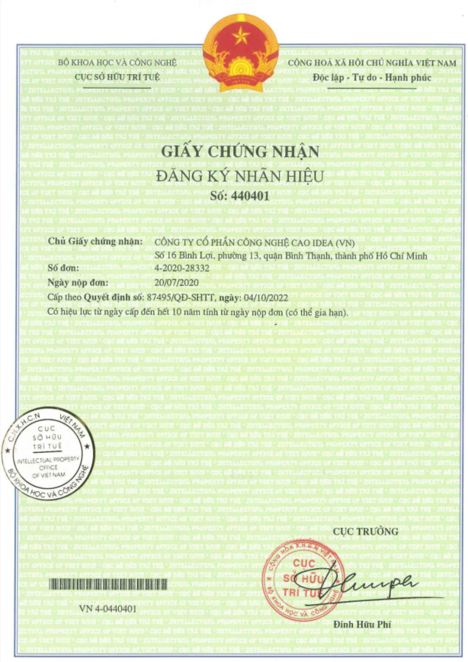
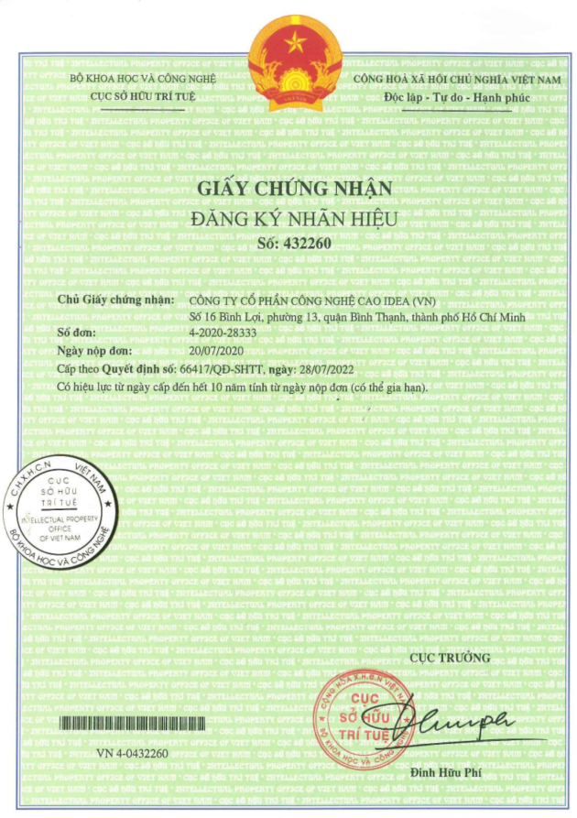



IDEA Group IDEA TECHNOLOGY CORPORATION JSC
CERTIFICATE OF
EXCLUSIVE TRADEMARK

Slide 8
IDEA Group IDEA TECHNOLOGY CORPORATION JSC
PART 3:
MEMBER COMPANIES WHICH ARE
SCIENCE AND TECHNOLOGY ENTERPRISES

Slide 9
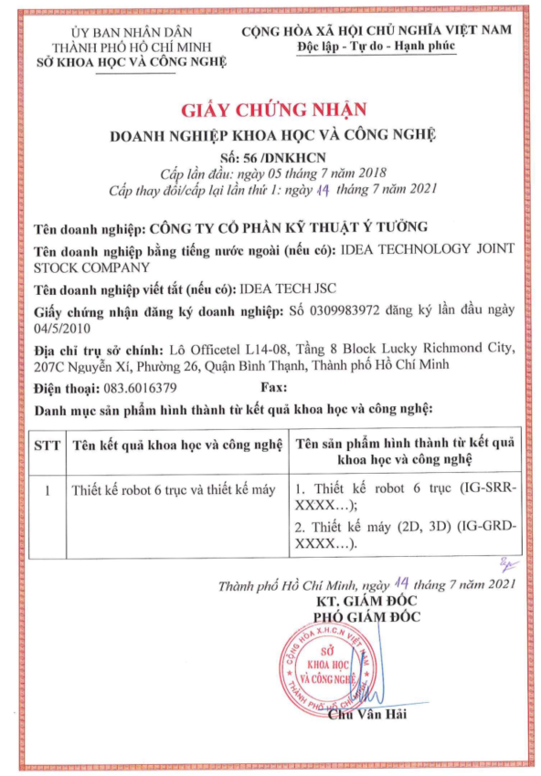
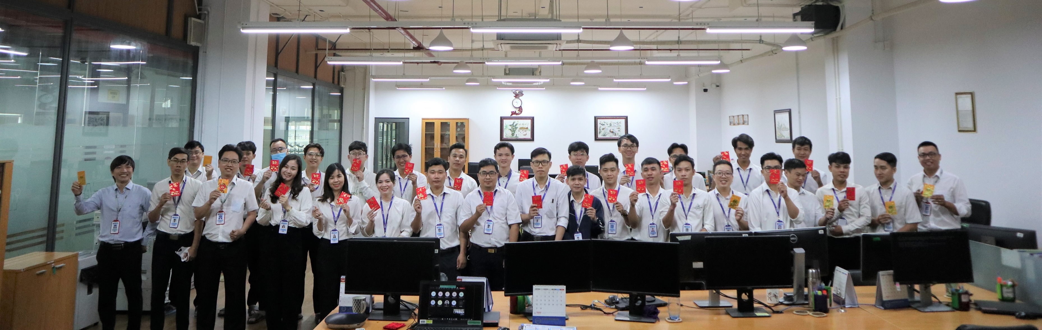
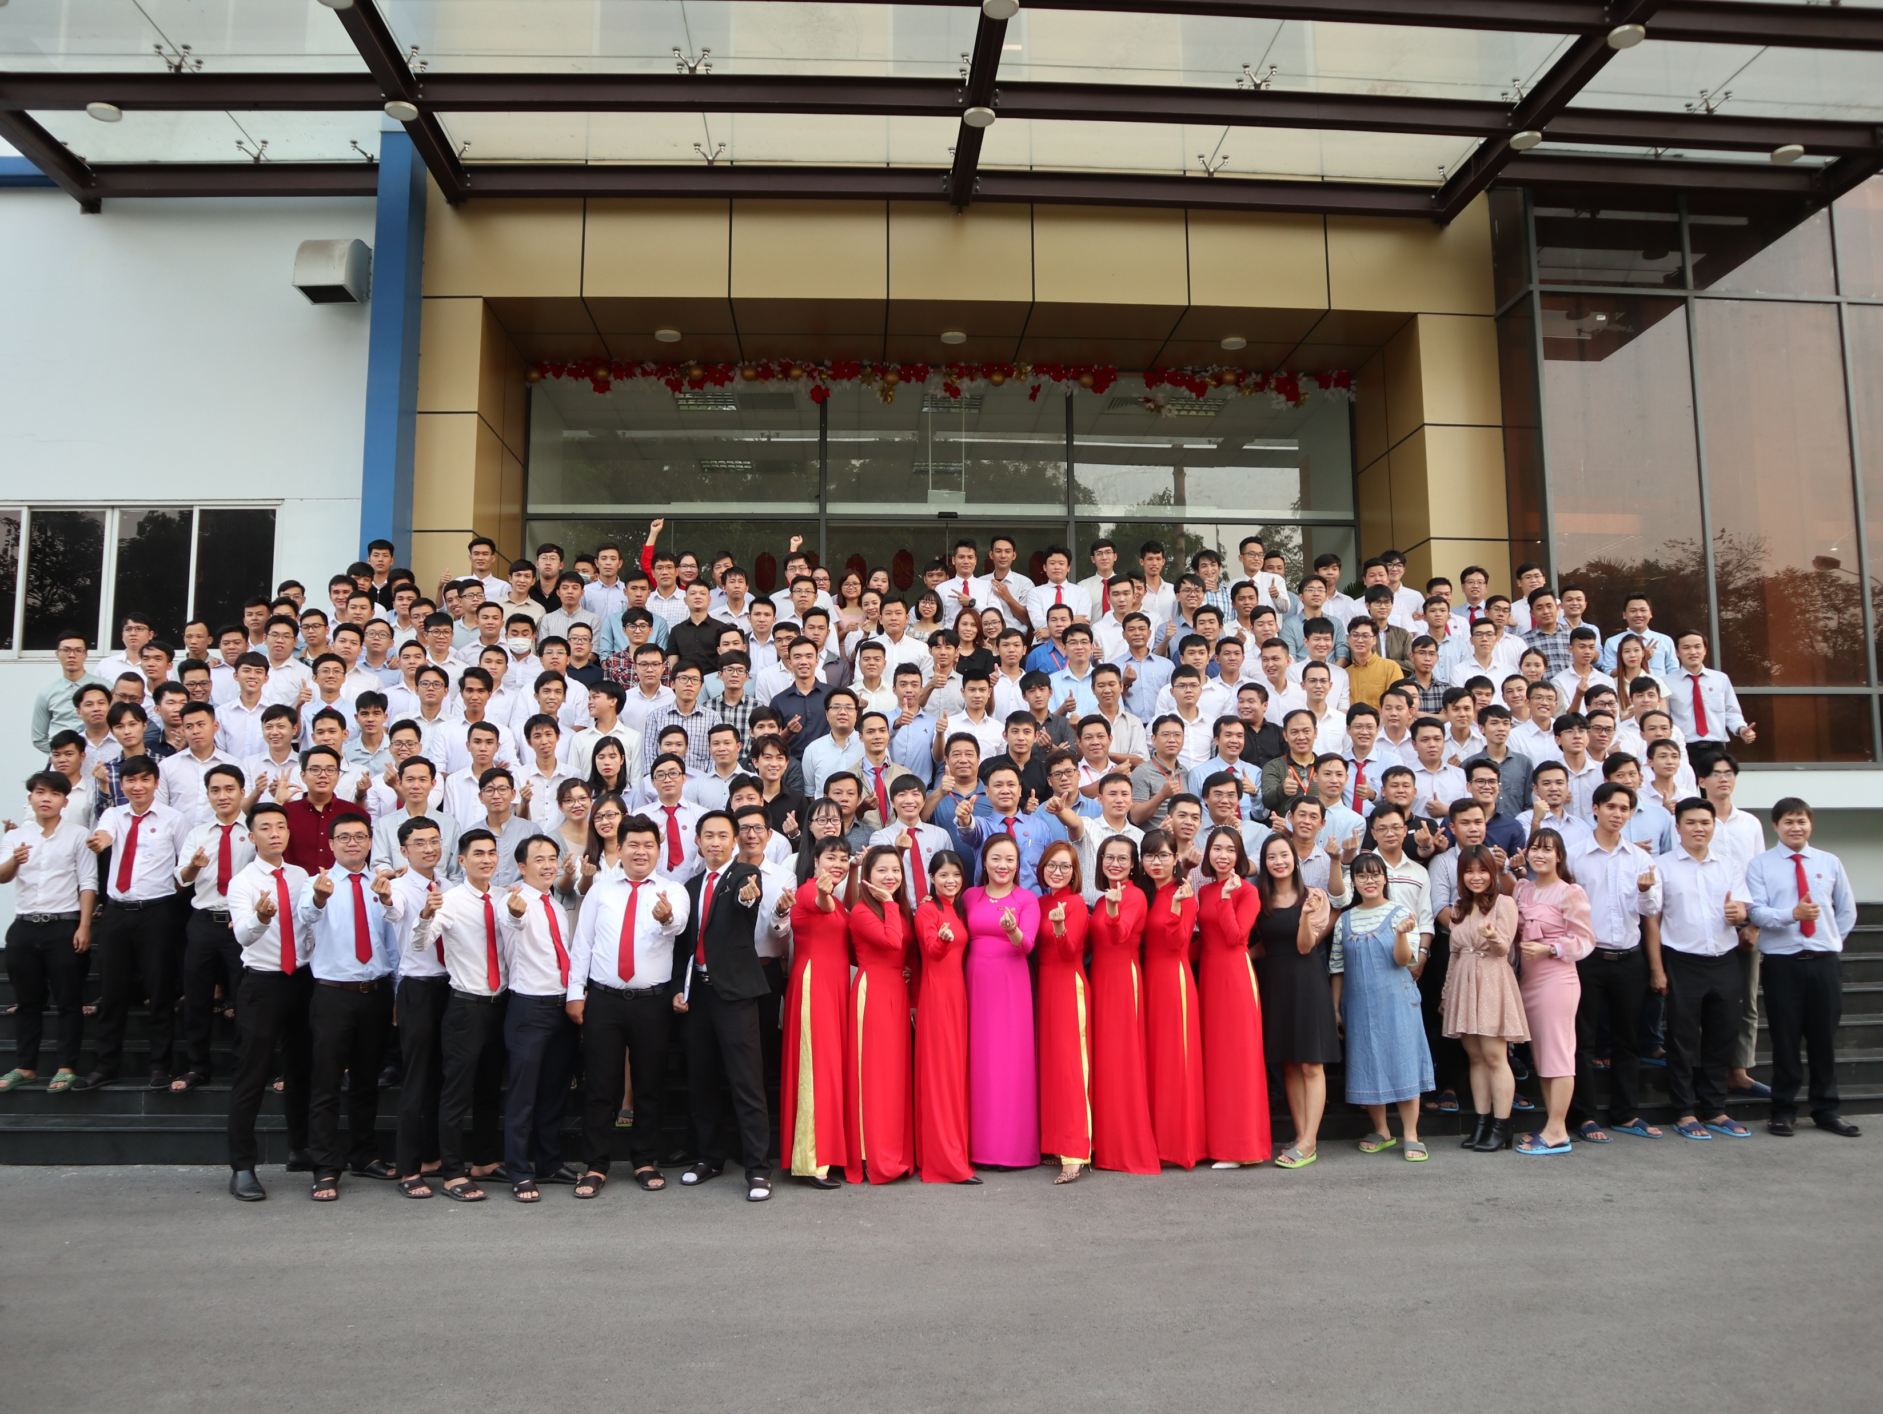
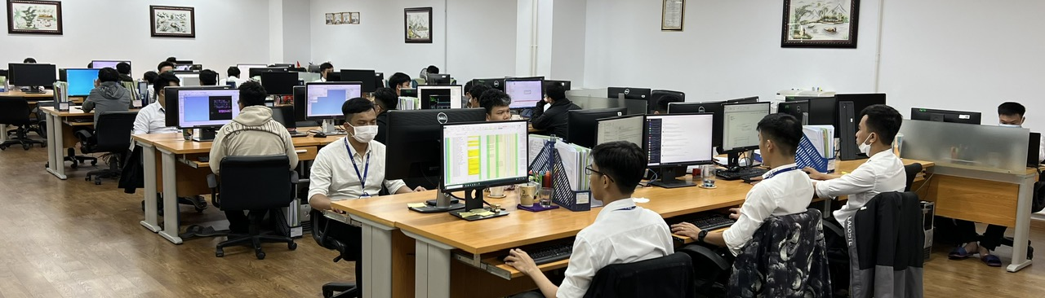
IDEA Group IDEA TECHNOLOGY CORPORATION JSC
SCIENCE AND TECHNOLOGY ENTERPRISE - IDEA TECHNOLOGY JOINT STOCK COMPANY

Slide 10
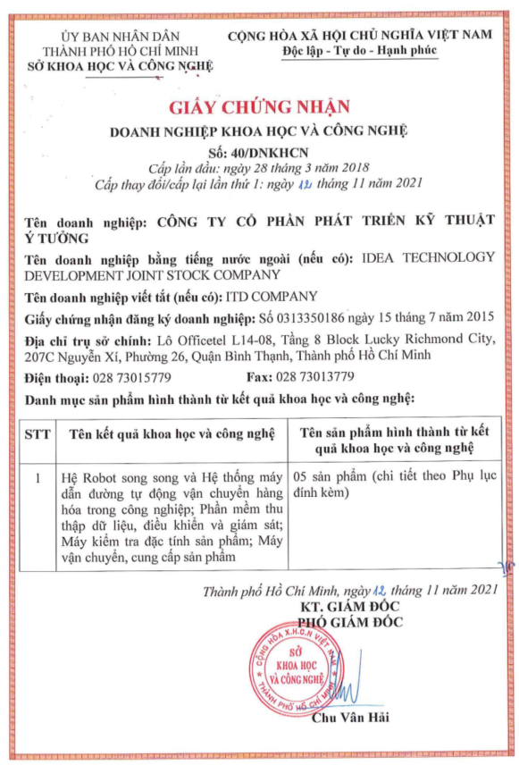
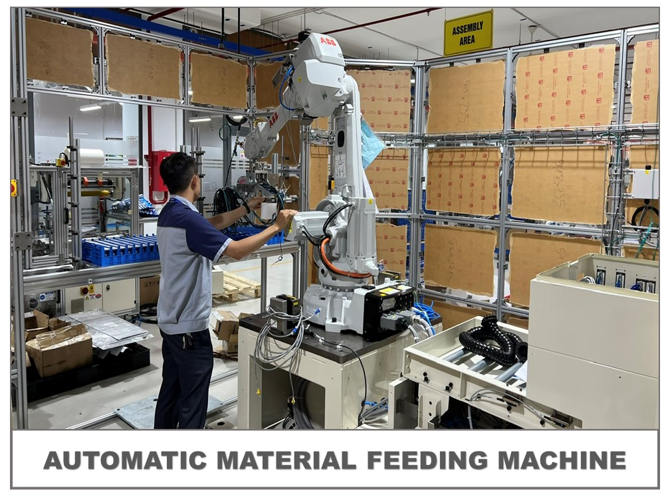
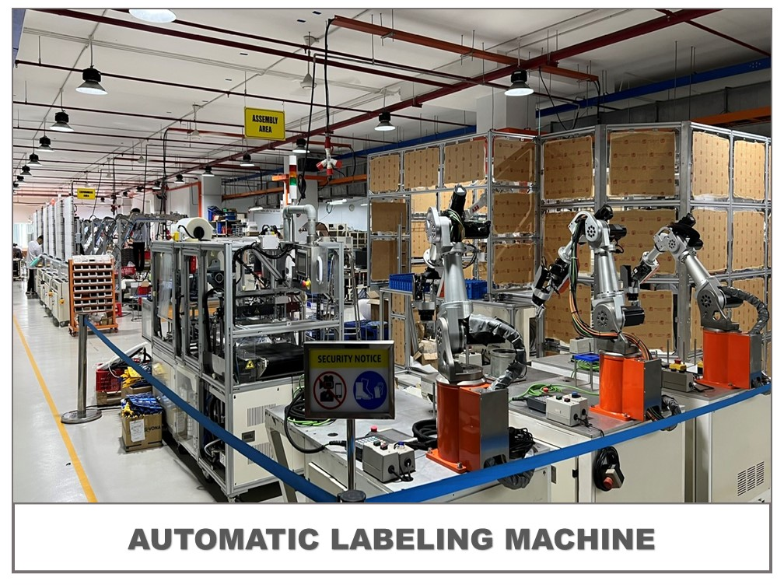
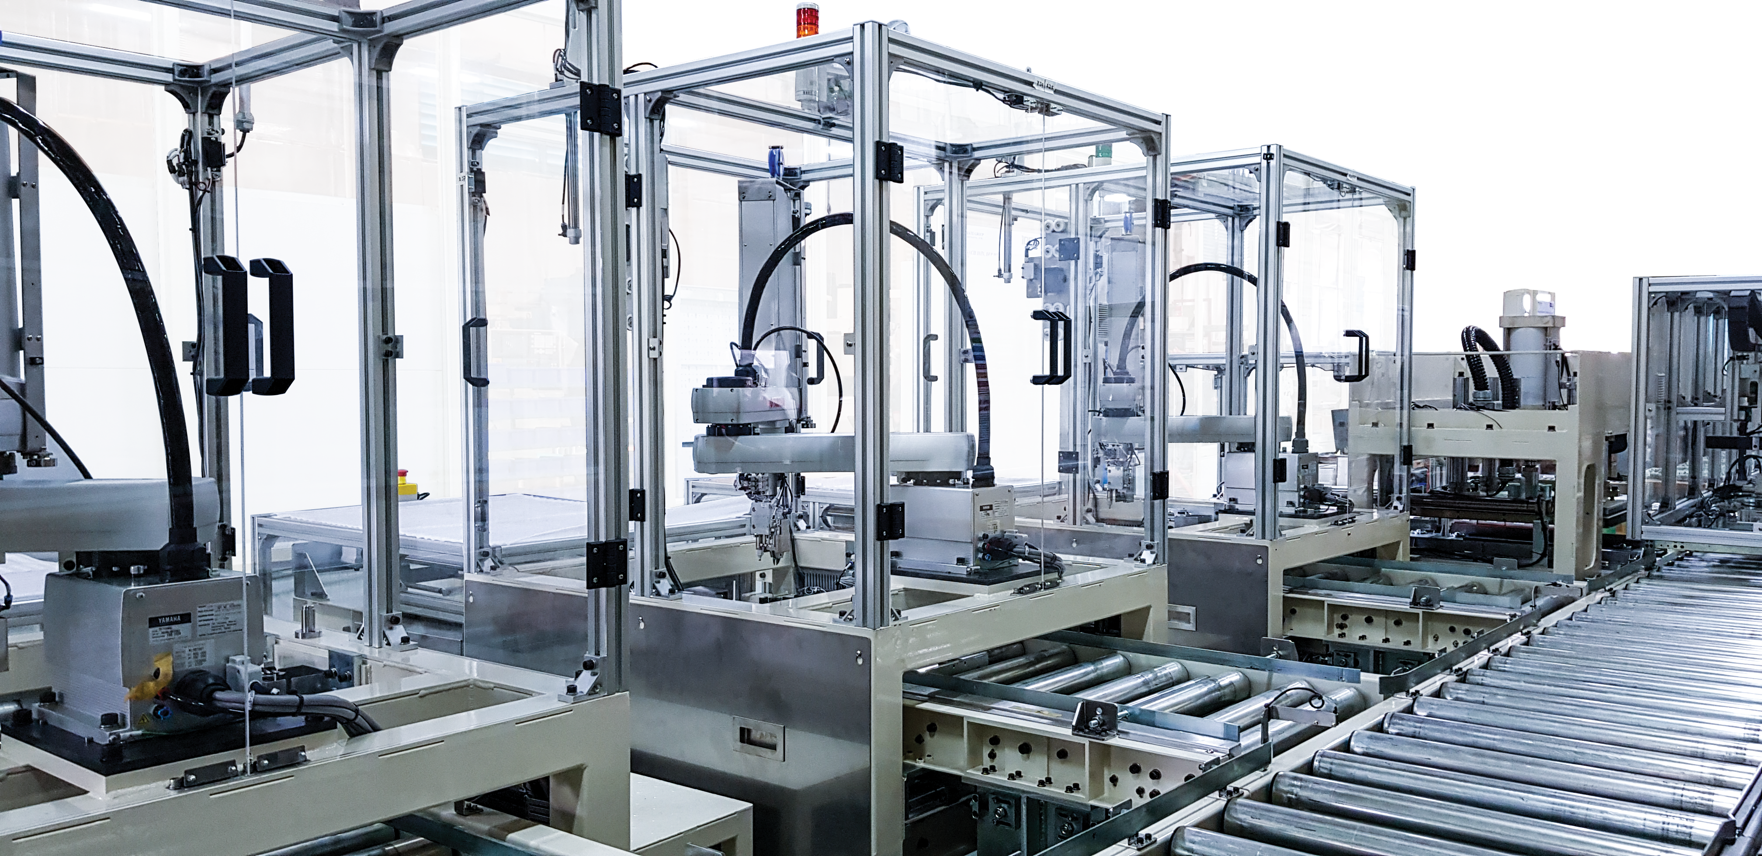
IDEA Group IDEA TECHNOLOGY CORPORATION JSC
SCIENCE AND TECHNOLOGY ENTERPRISE –
IDEA TECHNOLOGY DEVELOPMENT JOINT STOCK COMPANY

Slide 11
IDEA Group IDEA TECHNOLOGY CORPORATION JSC
PART 4:
RESEARCH AND DEVELOPMENT ACHIEVEMENTS

Slide 12
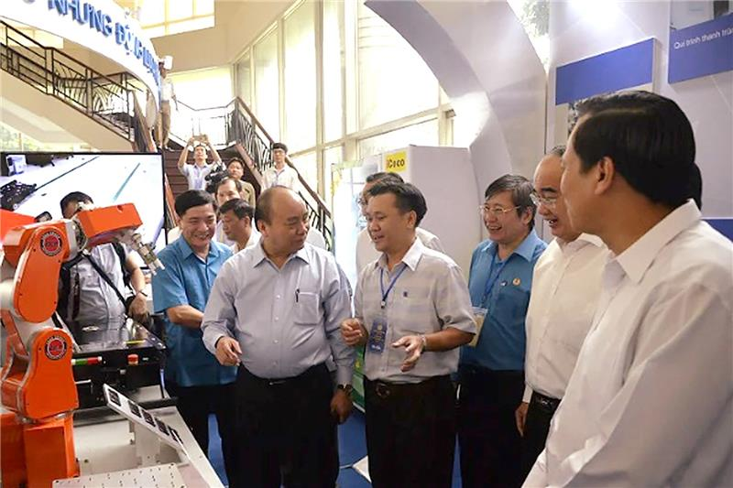
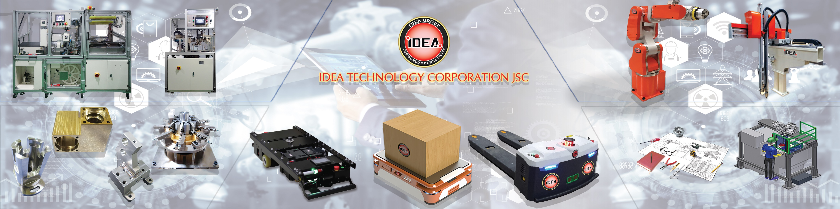
IDEA Group IDEA TECHNOLOGY CORPORATION JSC
- Developed 4 lines of automated guided vehicles, meeting flexible requirements for goods transportation applications within factories
- Developed 2 lines of 6-axis robots exported to Japan, 2 lines of delta robots, and 1 line of 3-axis robots.
- Developed some vending machine models, with a focus on control systems, management systems, and flexible payment methods.
- Developed production management software on the iSmartSite platform, providing management solutions for IDEA Group and some customers.

Slide 13
IDEA Group IDEA TECHNOLOGY CORPORATION JSC
PART 5:
ACHIEVEMENTS IN MACHINE DESIGN AND MANUFACTURING

Slide 14
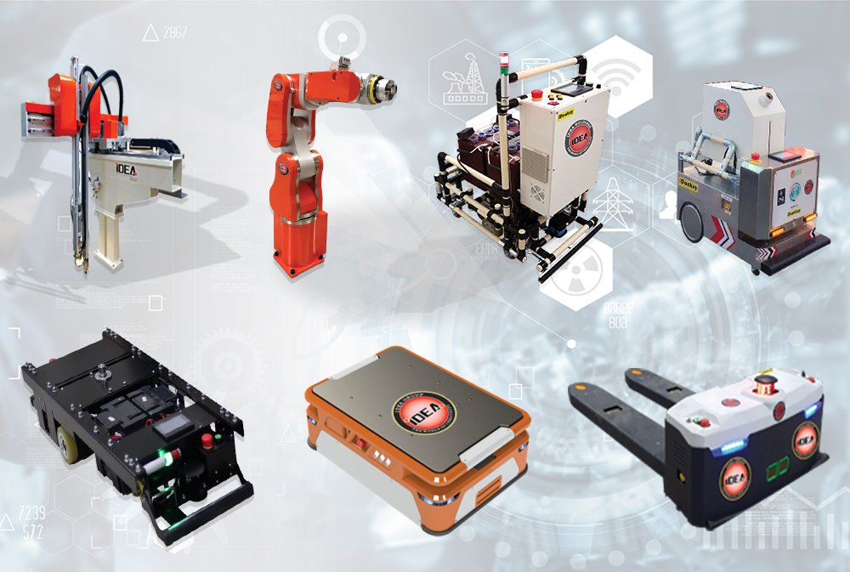
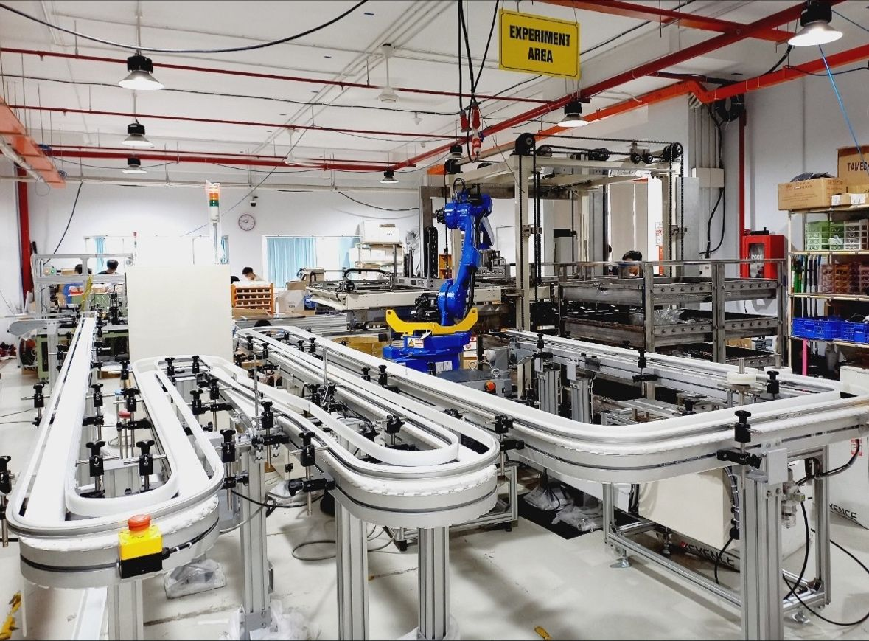
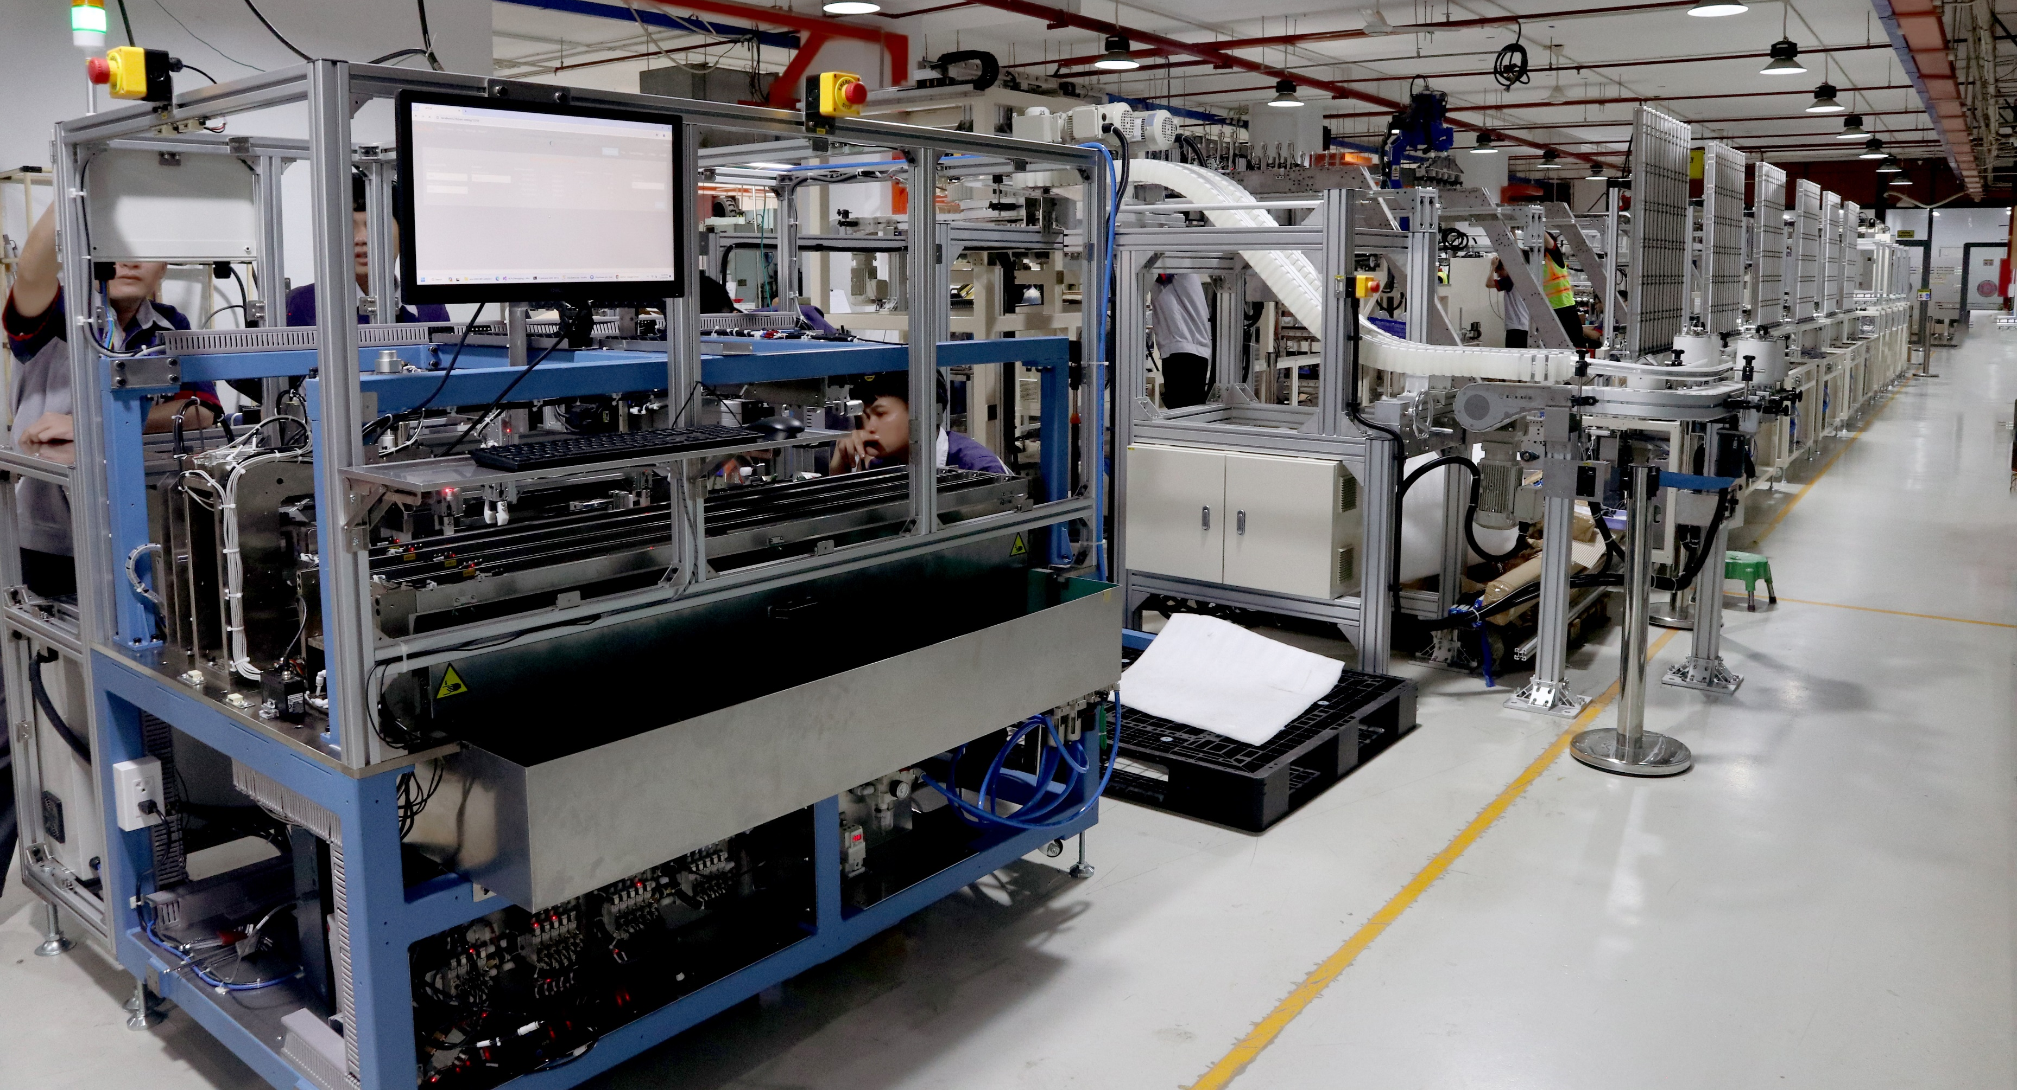
IDEA Group IDEA TECHNOLOGY CORPORATION JSC
- Completed over 500 machine design projects, machine control programming, and exported designs to the Japanese market. The fields covered various industries such as automotive, semiconductor, and consumer goods...
- Designed and manufactured over 300 automation systems primarily serving the domestic market and some exports

Slide 15
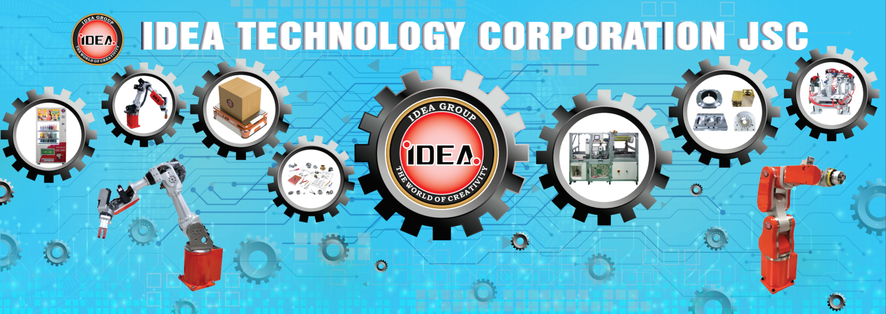
B. TECHNOLOGICAL INNOVATION ORIENTATION
1. Implement comprehensive digitalization of production and business management activities.
2. Continue to develop and package comprehensive solutions for automation, control, and robotics; Based on IDEA's research and combined with advanced solutions from collaborating partners such as Siemens, BeckHoff, Seer...

Slide 16


